Slide 1

Structure & Properties of Matter
Science TAKS Review
Objective 4

Slide 2
7A
Investigate and identify properties of fluids including density, viscosity, and buoyancy

Slide 3
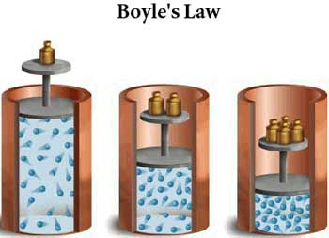

Fluids: a substance that can flow and take shape of its container.
Gases – can be compressed
Liquids – diffuse slowly (spread out evenly)

Slide 4
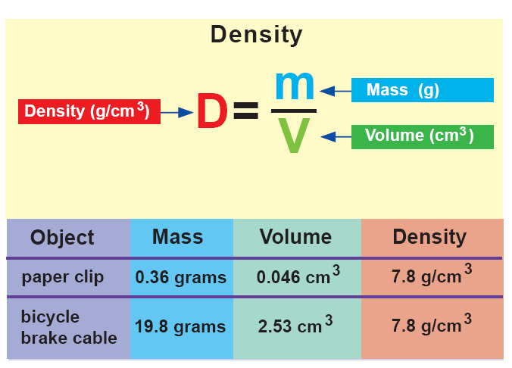
The density of steel is the same! Size doesn’t matter! It is a ratio!
Density of Steel
steel bar

Slide 5
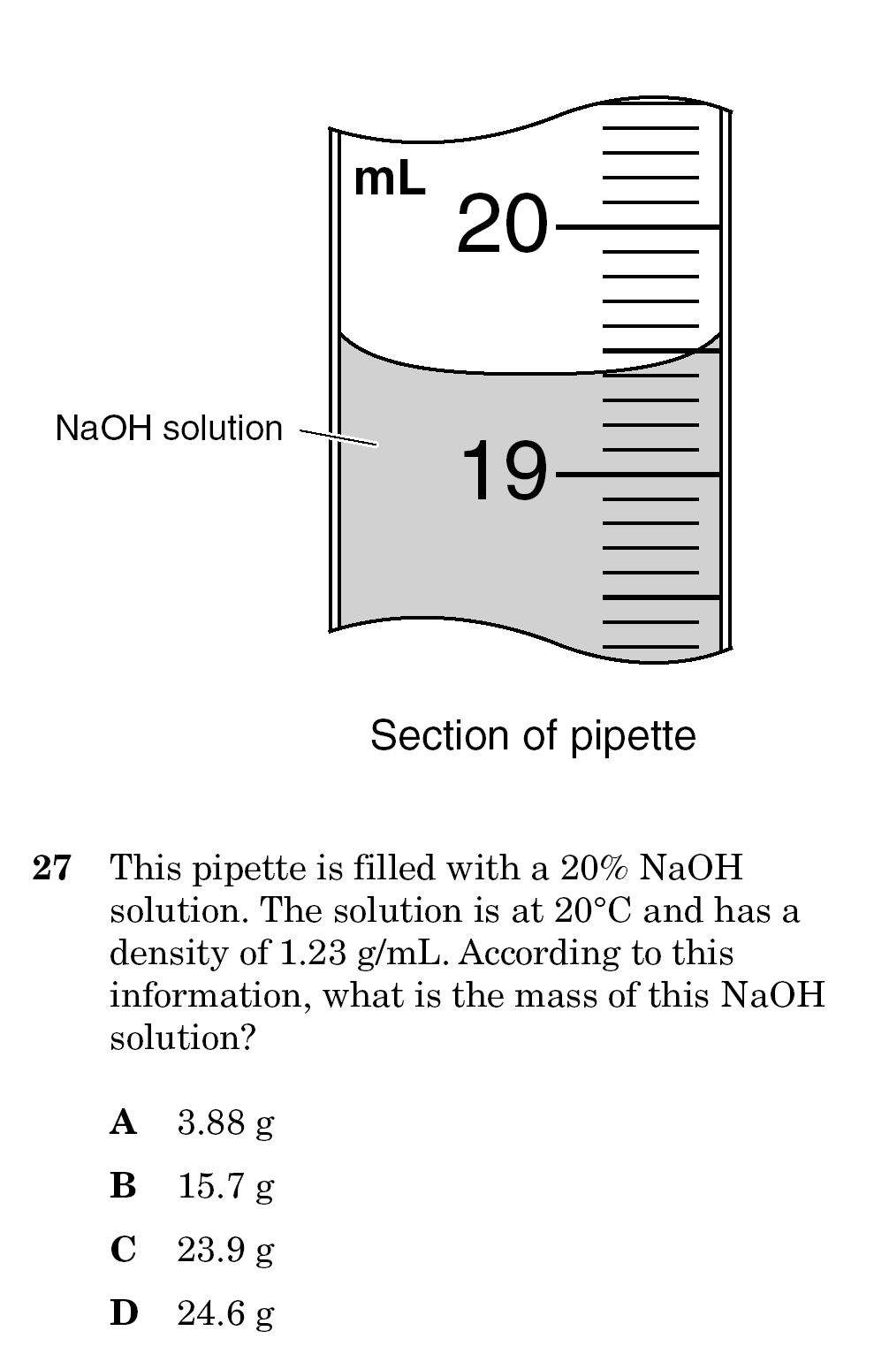
Use the formula sheet – you are given the density and you can read the volume from the cylinder!

Slide 6
Which one floats? Why?
Density of Water: 1.00 g/mL
Density of Ice: 0.92 g/mL
Ice! Because it is less dense.

Slide 7
The density of water is 1 g/ml
Anything more than that will sink!
The table shows properties of four liquids that are insoluble in water. If the four liquids are poured into an Erlenmeyer flask containing water, which liquid will form a layer below the water?
A Q
B R
C S
D T

Slide 8

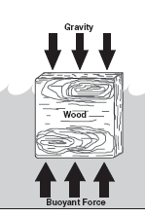
Buoyancy
is the tendency of a less dense
substance to float in a
more dense liquid.
Boats are made so that they have a lower density than water.

Slide 9
Viscosity
is the resistance to flow.
Which is more viscous?
warm syrup or cold syrup?
Cold syrup (high viscosity), because of the strength
of attraction between the particles.

Slide 10
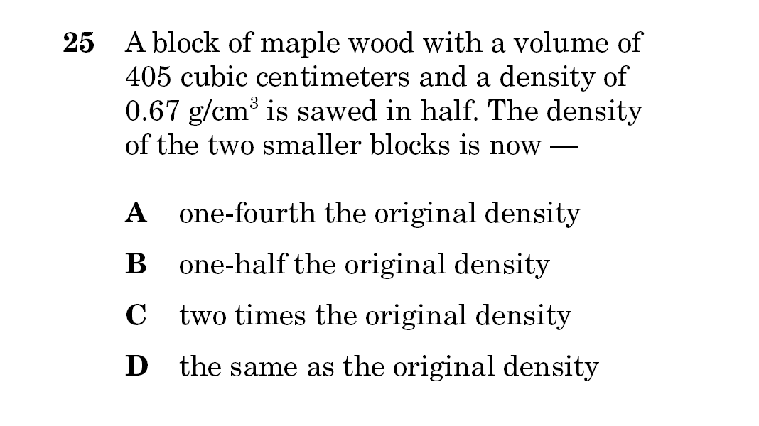
REMINDER: Density is a ratio! As long as the substance is the same – the density is the same!

Slide 12
7D
Relate the chemical behavior of an element including bonding, to its placement on the periodic table

Slide 13
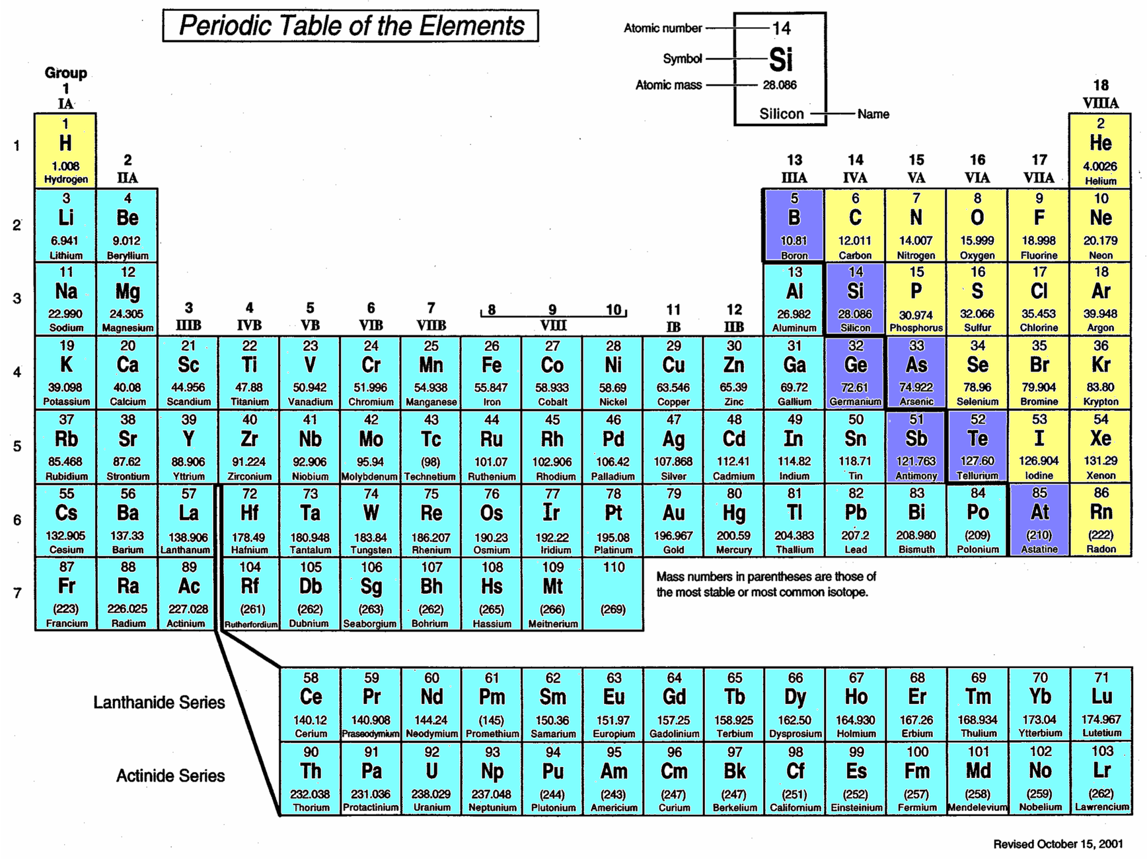
Nonmetals
Metals
↑Metalloids↑

Slide 14

Groups or Family Names
1) ALKALI METALS
2) ALKALINE METALS
17) HALOGENS
18) NOBLE GASES
TRANSITIONMETALS
Inner earth metals

Slide 15
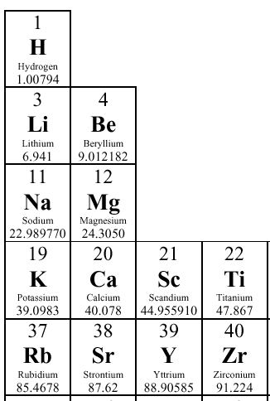
(# protons) ←Atomic No.
14
Silicon
Si 28.086
←Element Symbol
←Atomic Mass
←Element Name
Groups/Family (down)
Atoms are Neutral: (#protons = # electrons)
How many protons?
How many electrons?
14
Periods (across)
14

Slide 16
A certain atom has a nucleus containing six
protons and eight neutrons and has six
electrons orbiting the nucleus. This atom is a
form of the element —
A silicon
B carbon
C magnesium
D calcium
Elements are identified by the number of protons which = the atomic number!

Slide 17
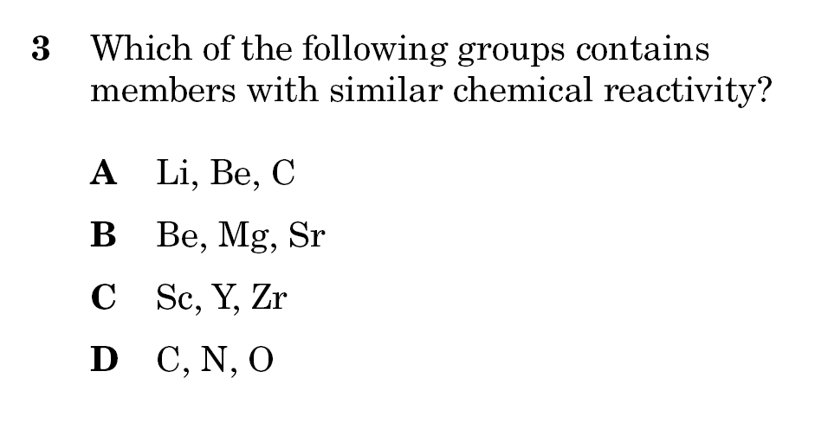
HINT: Same family = similar properties due to same # of valence electrons

Slide 18
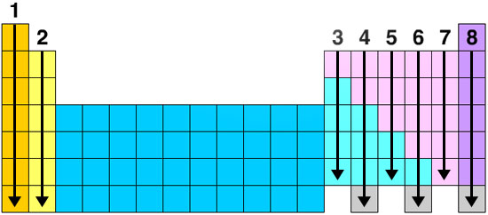
Number of Valence Electrons
Valence Electrons:
Are electrons in the highest energy level. The noble gases have 8 electrons.
All elements will gain, lose, or share electrons to end up with 8 electrons like the noble gases.
This is called the Octet Rule.

Slide 19
Net Ionic Charges
Metals will LOSE electrons to form positive ions.
Nonmetals will GAIN electrons to form negative ions.

Slide 20
Use your PT
Which of these elements is most likely to donate one electron?
F Be
G Cs
H Rn
J He

Slide 21
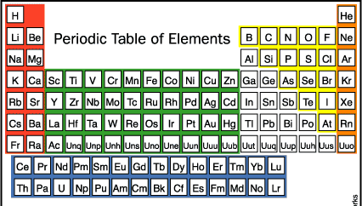
Chemical Reactivity
Metals increase in reactivity left and down.
Most reactive metal is?
Nonmetals become more reactive up and to the right.
Most reactive nonmetal is?
Fr
Noble Gases are inert gases…
(don’t react easily)
F

Slide 22
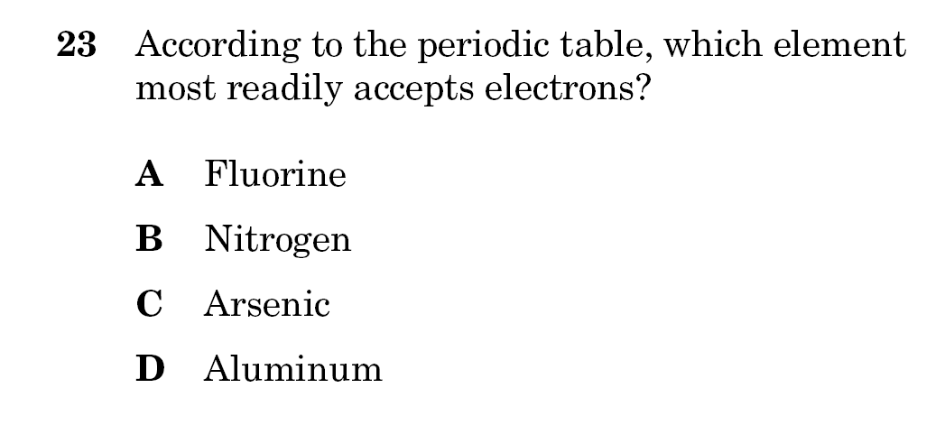

Slide 23
How many atoms do you need?
Atoms will join so the sum of all the charges = zero
O²⁻
Al³⁺
O²⁻
Al³⁺
O²⁻
You need 2 Al atoms & 3 O atoms: Al₂O₃

Slide 24
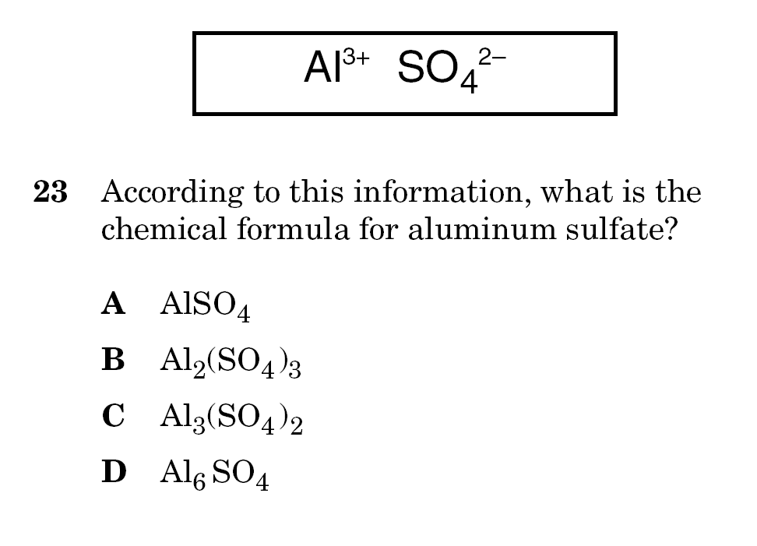

Slide 25
7E
Classify samples of matter from everyday life as being elements, compounds, or mixtures

Slide 26
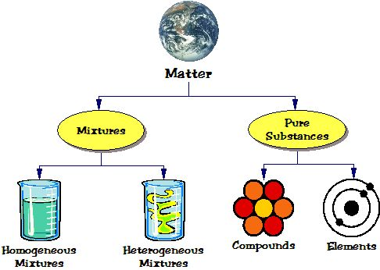

Has mass and volume (s, l, g)
More than one type of matter physically combined
One type of matter
Uniform throughout (aka. solutions)
Not uniform throughout
Two or more elements chemically combined
One type of atom – cannot be separated

Slide 27
Properties of Matter
Property – a characteristic
Physical properties:
characteristics that can be observed or measured without changing the identity of the substance.
Ex. Color
    Density
    Solubility
Melting Point
Chemical properties:
characteristics of a substance’s “ability” to change into a different substance.
Ex. Reactivity
Flammability

Slide 28
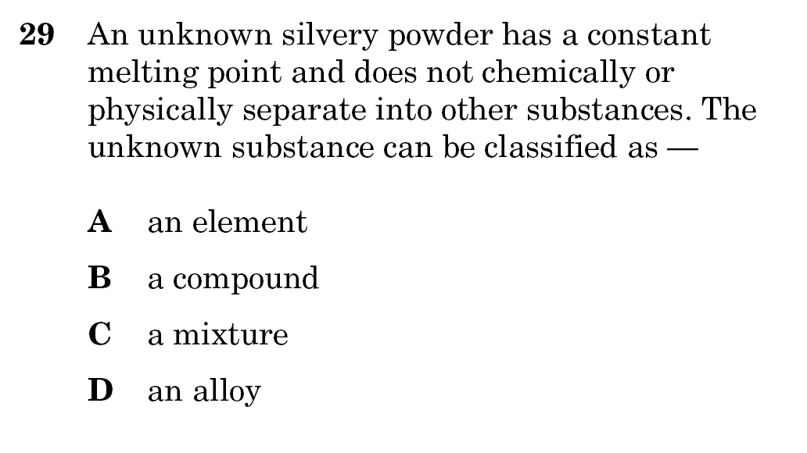

Slide 30
8A
Distinguish between physical and chemical changes in matter such as oxidation, digestion, changes in states, and stages in the rock cycle

Slide 31
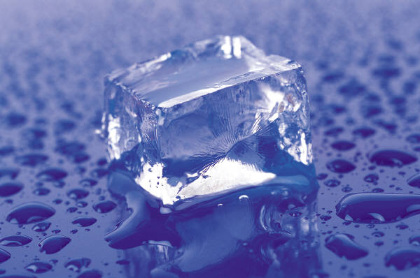
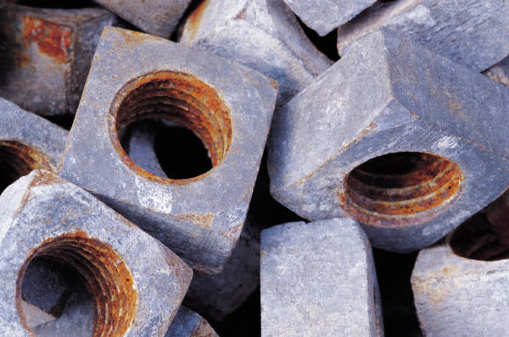
Changes of Matter
Physical Changes:
A change that does not produce a new substance.
Usually reversible.
Ex: Ice melts into water.
Chemical Changes:
A change that does produce a new substance.
Usually not reversible.
Ex: Iron rusts forming iron oxide.

Slide 32
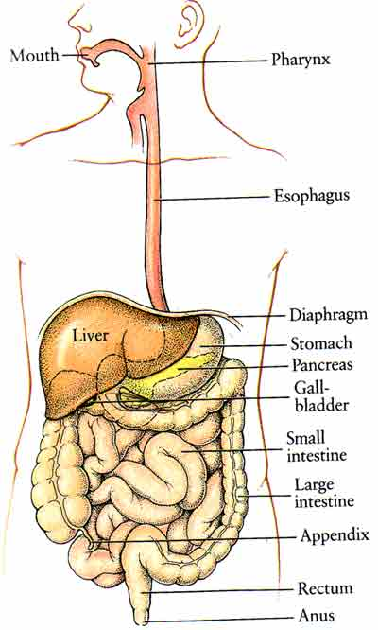
How do you know a chemical change has occurred?
Physical
change
begins
in the
mouth
Evidence of a
Chemical Change:
Energy (Heat):
  absorbed energy (endothermic)
  released energy (exothermic)
Gas is produced (bubbles)
Solid (precipitate) forms
Odor or color change occurs
Chemical
change
(Digestion)
occurs
in the
stomach

Slide 33
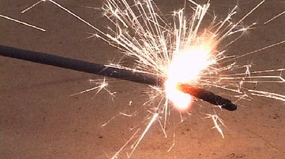
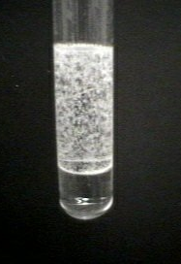
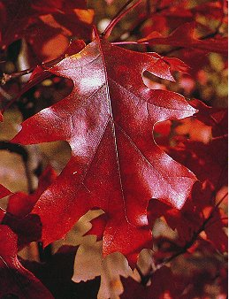
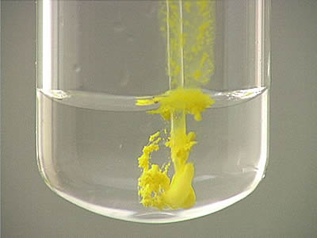
Why are these chemical changes?

Slide 34
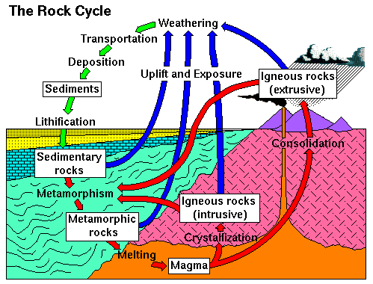
The Rock Cycle
One of nature’s slowest processes – the rock cycle – is a repeating series of physical and chemical changes in which one type of rock changes to another type.

Slide 35
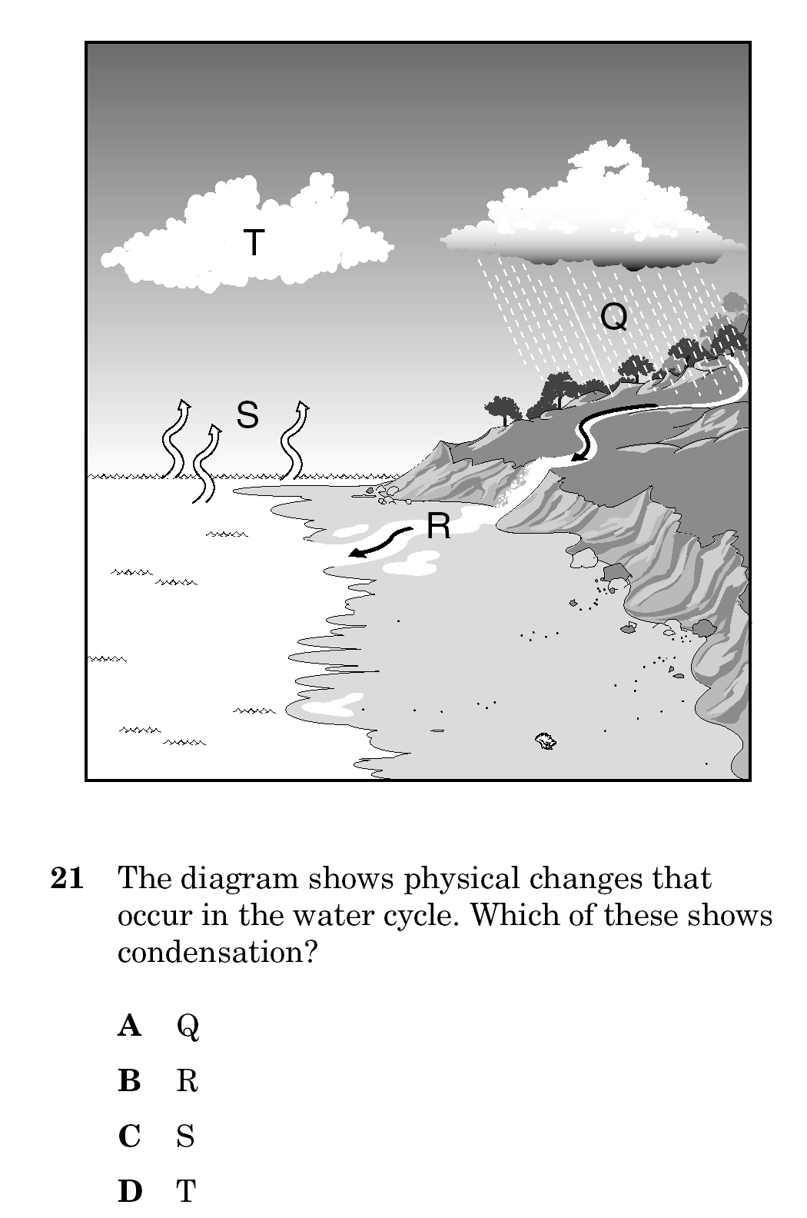

Slide 36
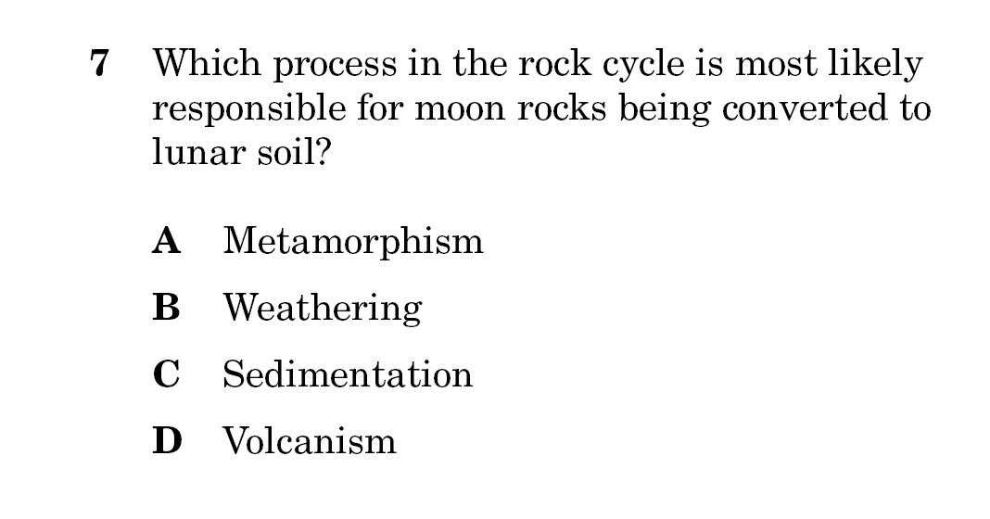

Slide 37
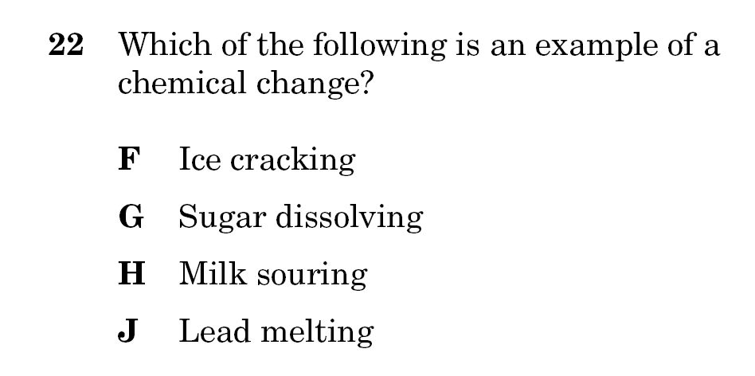

Slide 38
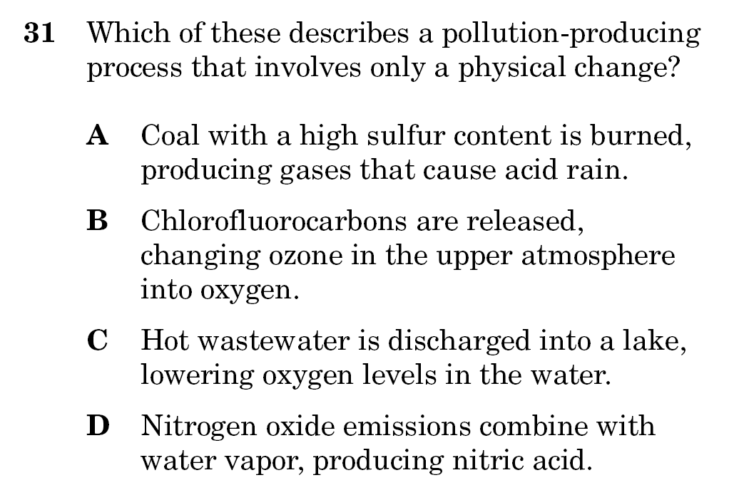

Slide 39
8C
Investigate and identify the law of conservation of mass

Slide 40
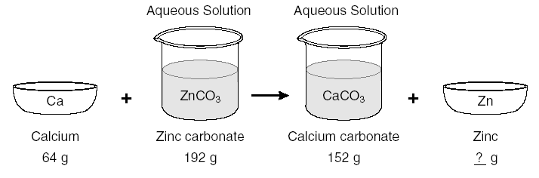
Law of Conservation of Mass/Matter
-Mass is neither created nor destroyed!
The total mass of the substances before they are mixed is equal to the total mass as a mixture.
64 + 192 = 256 g
Zn = 104 g

Slide 41
Mass of the reactants = Mass of the products …Always!
1CH₄ + 2O₂ → 1CO₂ + 2H₂O
1 C, 4 H, 4 O = 1 C, 4 H, 4 O
(1x12.0) + (4 x 1.0) + (4x16.0) = (1x12.0) + (4 x 1.0) + (4x16.0)
80 g = 80 g
Ex: How many grams of oxygen react with 16 g of CH₄ to create 80 grams of products?
Reactants = Products
x g + 16 g = 80 g
x = 80-16
= 64 g O₂

Slide 42
Balancing Chemical Equations
CH₄ (g) + O₂ (g) → CO₂ (g) + H₂O (g)
Count the number of atoms on both sides
of the arrow.
1 CH₄ (g) + 2 O₂ (g) → 1 CO₂ (g) + 2 H₂O (g)
Place a coefficient in front of the compound to
get the same number of atoms in the reactants
and in the products.

Slide 43
Guided Practice
Ex. 1: Mg + HCl → MgCl₂ + H₂
Ex. 2: KClO₃ −^{Δ} KCl + O₂
Balanced Equation:
Mg + 2 HCl → MgCl₂ + H₂
Balanced Equation:
2 KClO₃ −^{Δ} 2 KCl + 3 O₂

Slide 44
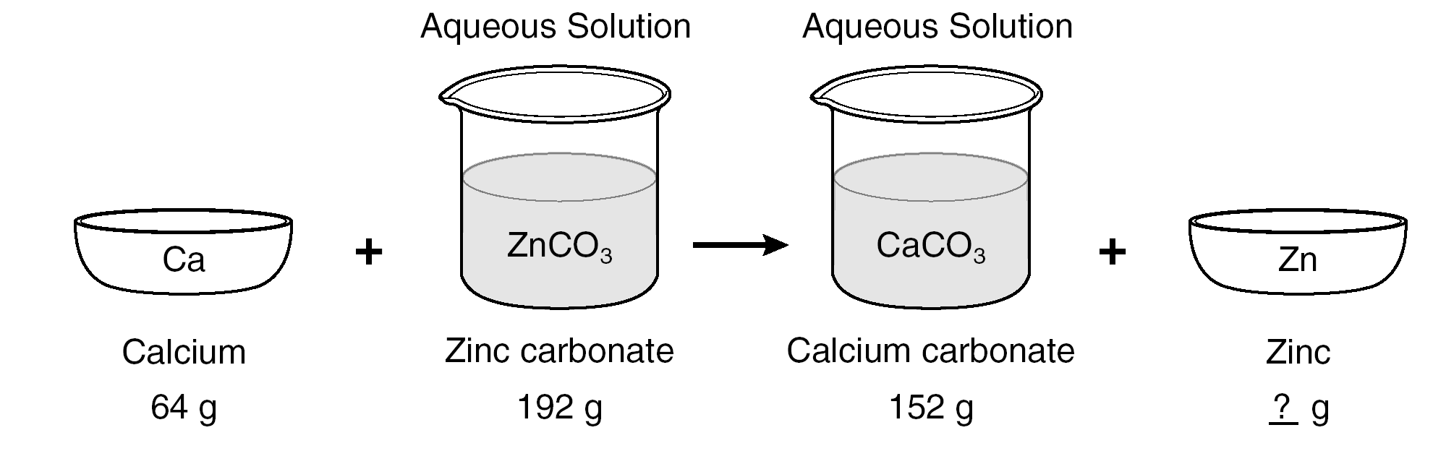
According to the law of conservation of mass, how much zinc was present in the zinc carbonate?
A 40 g
B 88 g
C 104 g
D 256 g

Slide 46
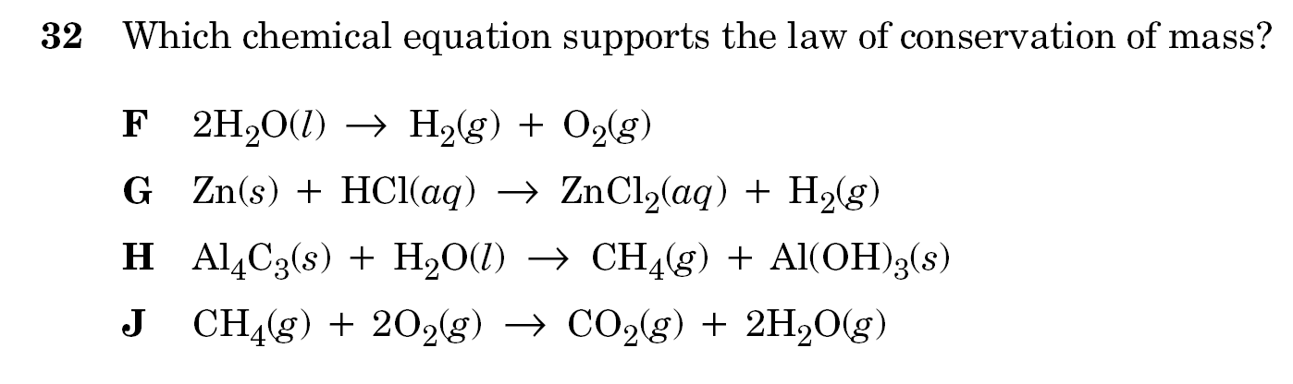
In other words: which one is balanced correctly?

Slide 47
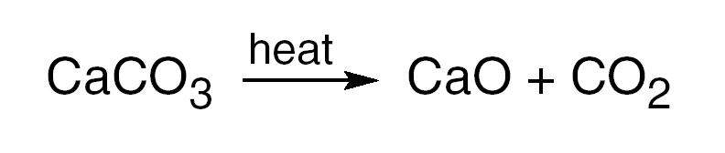
The chemical equation shows CaCO3 being heated. Which of these statements best describes the mass of the products if 100 g of CaCO3 is heated?
A The difference in the products’ masses is equal to the mass of the CaCO3.
B The sum of the products’ masses is less than the mass of theCaCO3.
C The mass of each product is equal to the mass of the CaCO3.
D The sum of the products’ masses equals the mass of the CaCO3.

Slide 48
9A
Relate the structure of water to its function as the universal solvent

Slide 49
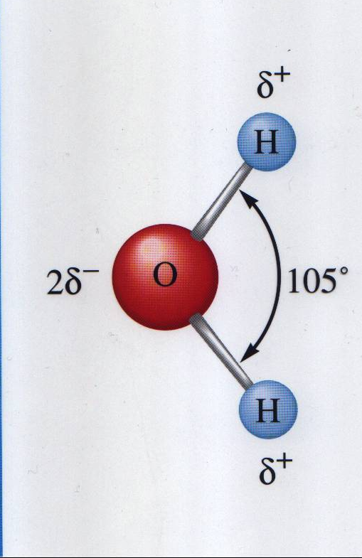
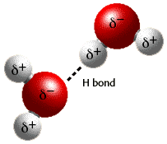
Structure of Water
Polar Molecule:
Hydrogen: Partial positive (δ+) charge Oxygen: Partial negative (δ−) charges.
Hydrogen Bonding
Hydrogen and Oxygen covalently bond to each other.

Slide 50
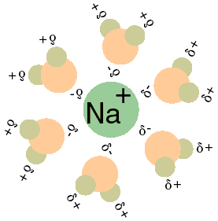
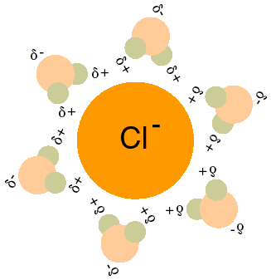
Water as a Universal Solvent
Dissolves so many other substances due to its structure/polarity.
Positive Ion Surrounded by oxygen (δ−)
Negative Ion Surrounded by hydrogen (δ+)

Slide 51
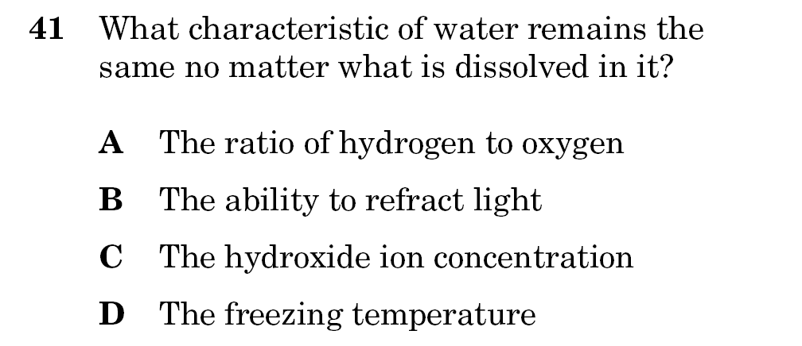
HINT: Any question that asks you about a characteristic of water will have an answer that deals with molecular structure (aka. The formula) including polarity!

Slide 52
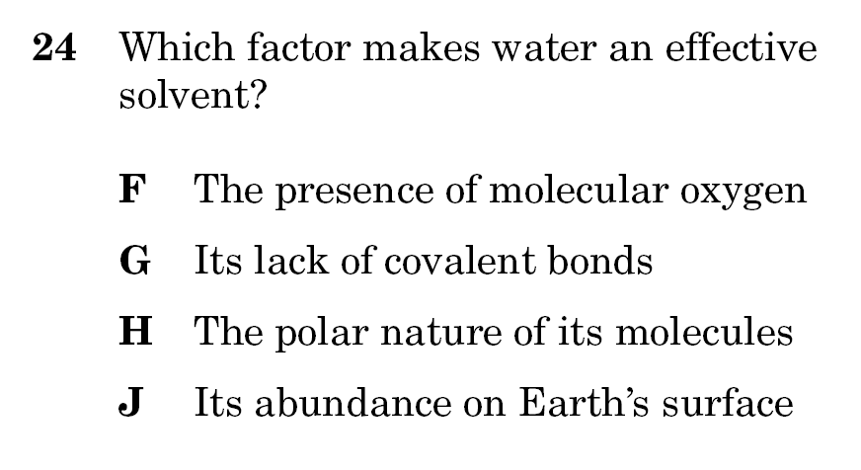

Slide 53
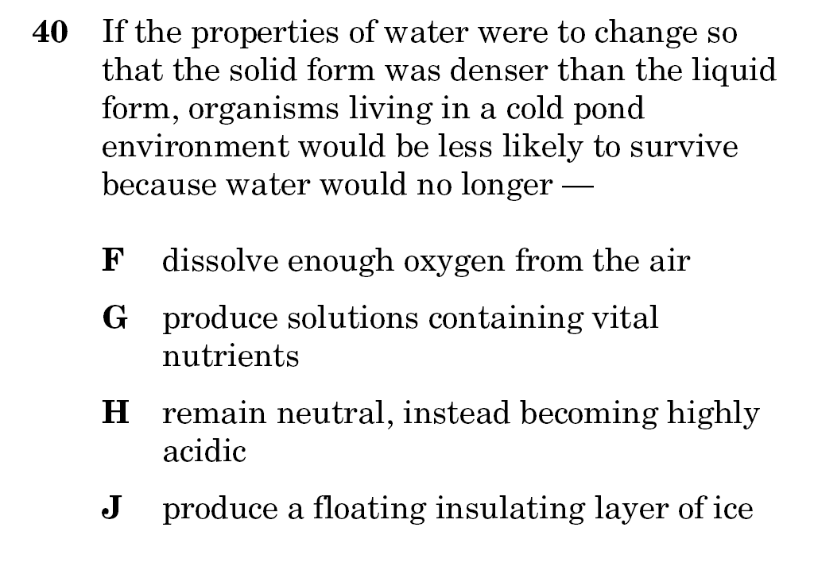

Slide 54
9B
Relate the concentration of ions in a solution to physical and chemical properties such as pH, electrolytic behavior, and reactivity

Slide 55
Concentrations on Solutions
Solutions can be solids, liquids, or gases.
Unsaturated
Saturated
Supersaturated
More solvent than solute. Ex. Lightly sweetened
Solvent has dissolved all the solute it can hold. Ex. Sweet tea
Solvent holds more solute than is normal. Ex. Rock candy
Dilute: solution made with little solute.
Concentrated: solution made with a lot of solute.

Slide 56
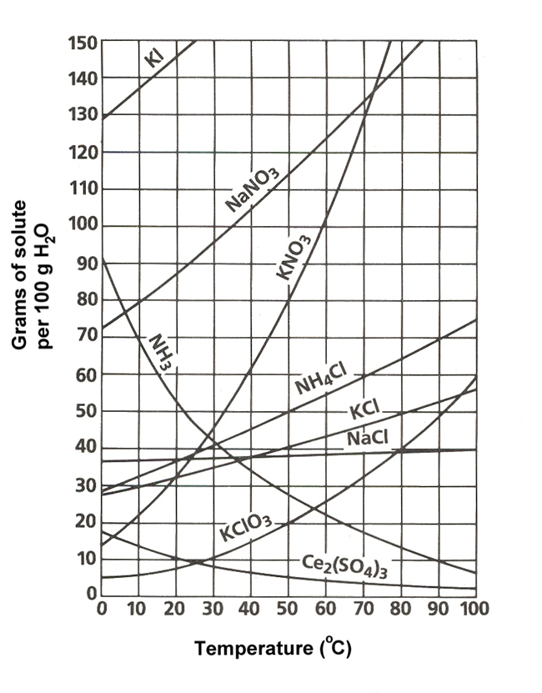
Solubility Curves
Look at KNO₃
Point on the line = Saturated
Point below the line = Unsaturated
Point above the line = Supersaturated

Slide 57

Solubility Factors
Temperature & Solids
Solubility increases as the temperature increases for most substances (upward curves)
Example: Dissolve sugar in hot tea vs. iced tea

Slide 58

Solubility Factors
Temperature & Gases
Solubility of gases in water decreases with increasing temperature.
Example: Soda pop
What happens when you leave a soda out on a hot day?
Carbon dioxide gas will go out as the soda warms up making it flat.
So keep your soda COLD!

Slide 59
Pressure & Gases
Solubility Factors
Solubility of liquids and solids isn’t affected much.
Gas solubility ALWAYS increases as pressure increases.
The way to get gas to dissolve in liquid is to pressurize the mixture, meaning that the pressure inside a soda can is greater than the pressure outside the can.

Slide 60
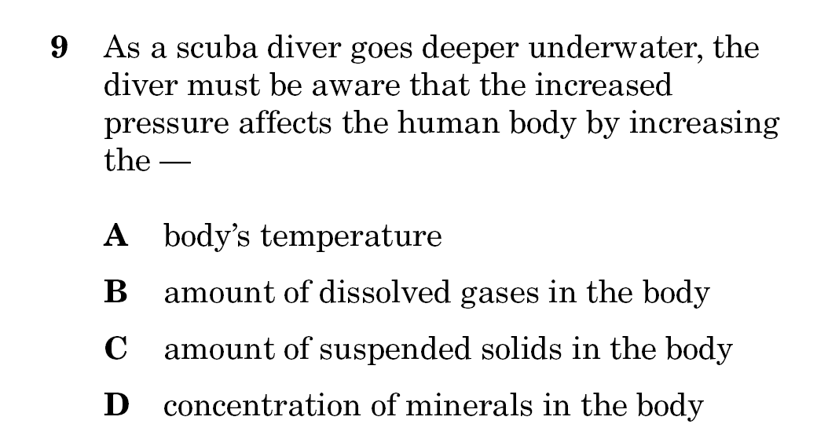

Slide 61
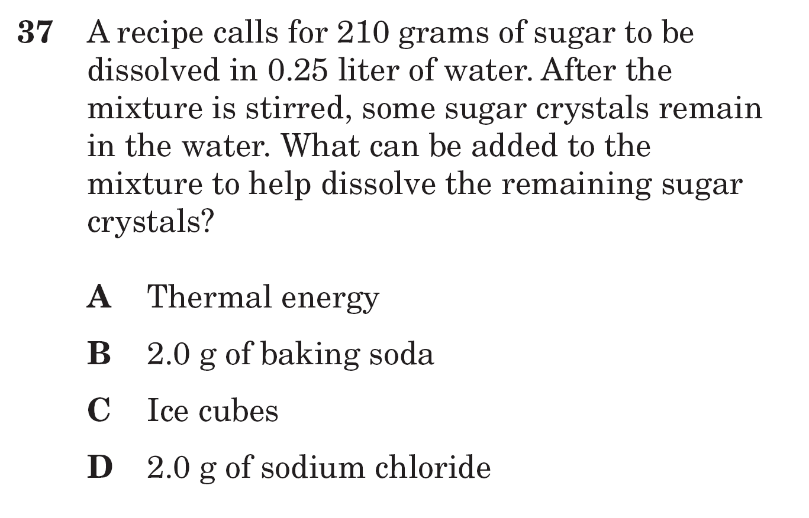

Slide 62
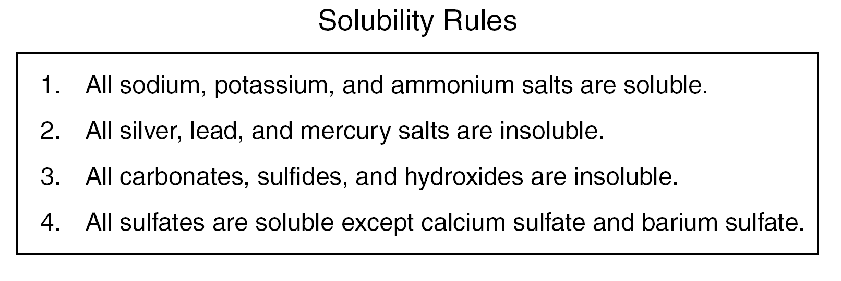
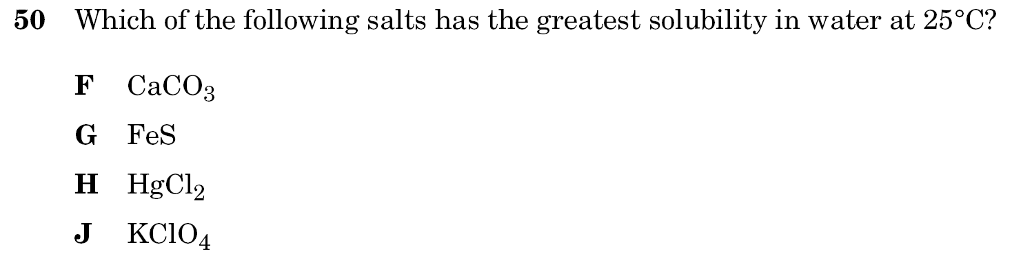

Slide 63
Electrolytic Behavior
Non-electrolyte: (ex. pure water) No ions present, thus, no electrical conductivity.
Weak electrolyte: (ex.weak acid/base) Few ions present, thus, poor electrical conductivity.
Strong electrolyte: (ex. Strong acid/base)
Salt completely breaks apart to give more ions, conduct more electricity.

Slide 64
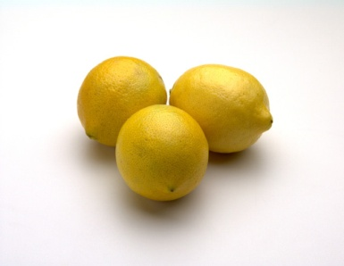
____ ___ ____
Acids are:
pH less than 7
Sour, like lemons
Change Blue litmus paper to red.
Forms Hydrogen ions
Bases are:
pH more than 7
Bitter and Slippery
Change Red litmus paper will to blue.
Forms Hydroxide ions.
H+
OH-

Slide 65
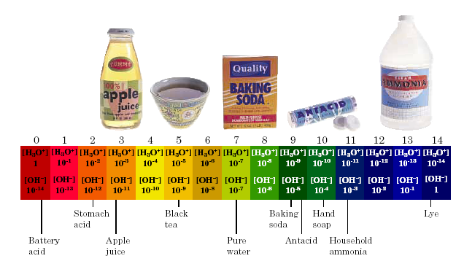
The pH Scale
Acid
Neutral
Base
Neutralization Reaction:
Acid + Base --> Salt + Water

Slide 66
Now You Try!

Slide 68
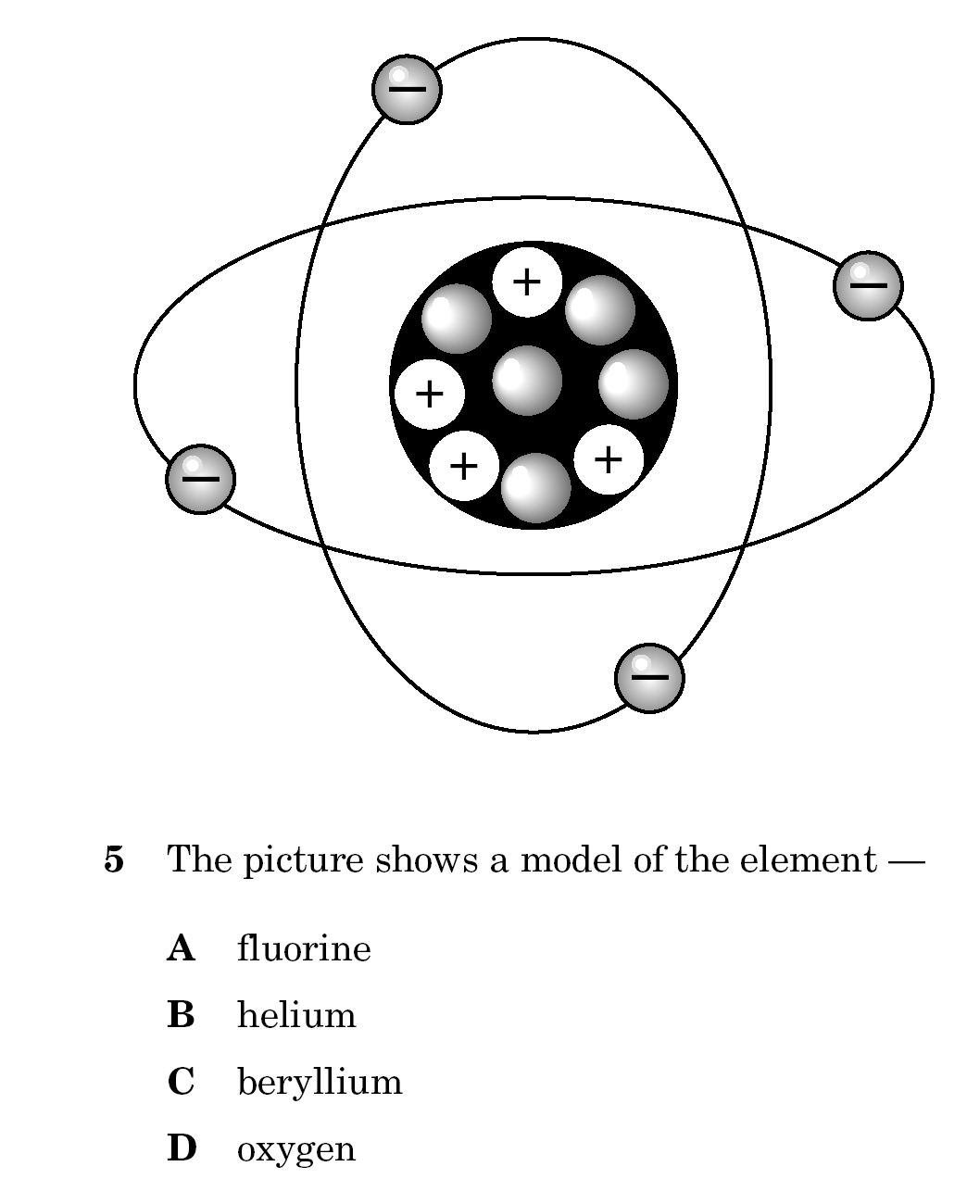

Slide 69
The bonding characteristics of oxygen are
most similar to the bonding characteristics
of —
A hydrogen
B silicon
C helium
D sulfur

Slide 70
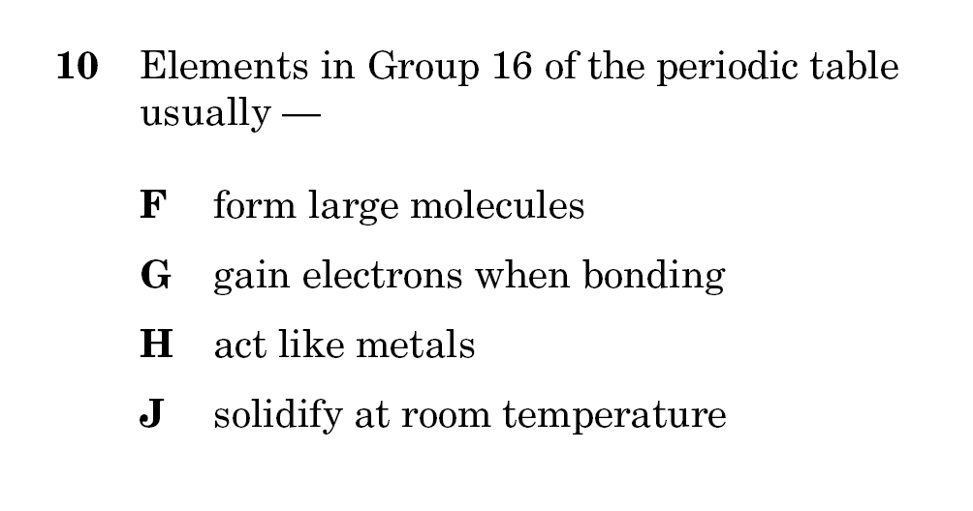
Know the properties of the groups/families!!

Slide 71
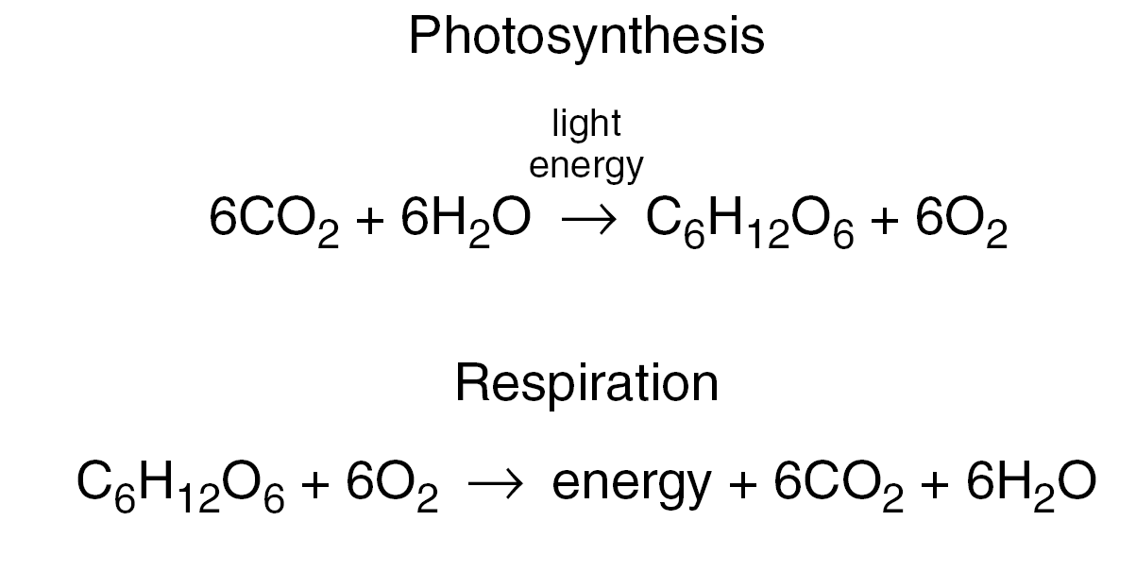
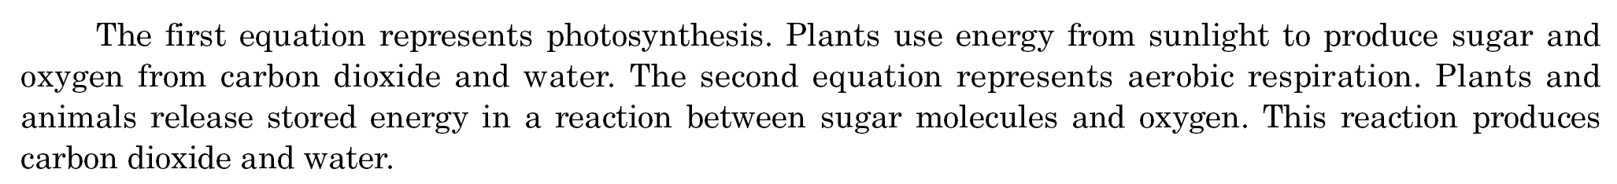
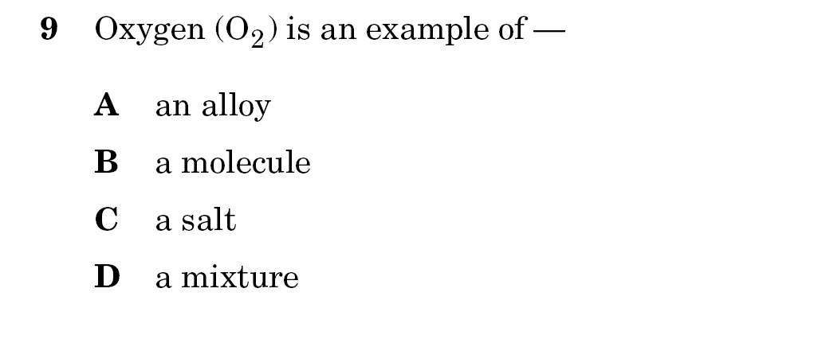

Slide 72
Compounds with the same chemical
composition may have different densities because they —
A have differences in reactivity
B are able to bond with oxygen
C vary in solubility
D exist in different phases

Slide 75
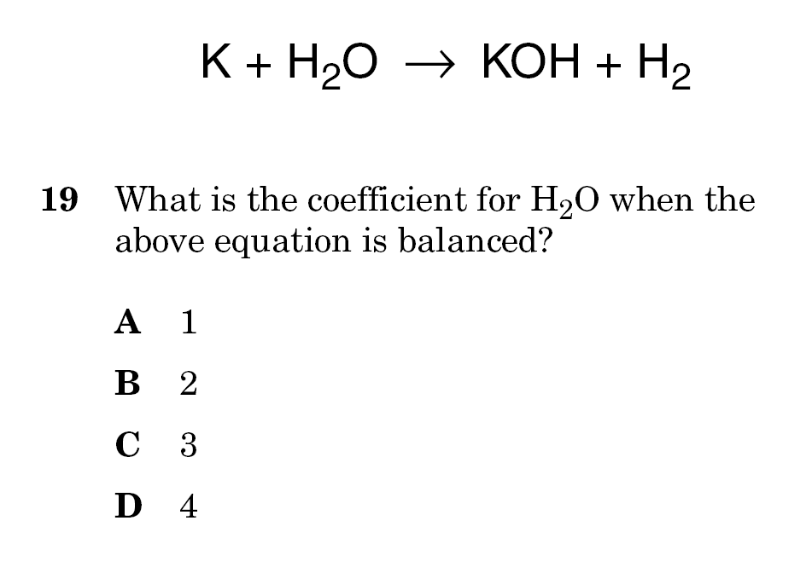

Slide 76


Slide 78
Which characteristic of water best explains its ability to dissolve a great variety of materials?
A Its transparency in light
B Its electrical conductivity
C Its physical state of matter
D Its molecular arrangement

Slide 79


Slide 80


Slide 81


Slide 82


Slide 83


Slide 84
Power plants that discharge warm water into
rivers have a negative effect on aquatic life.
This is because the higher water
temperature —
A increases the pressure of the river water
B increases the pH value of the river water
C decreases sediment solubility in the river
water
D decreases the dissolved oxygen in the
river water

Slide 85
Nine groups of students dissolved as much potassium chloride as possible in water. Each group used 100 mL of water heated to a different temperature. Which graph shows the relationship between solubility and temperature for potassium chloride?

