Slide 1

TAKS Objective 2
The student will demonstrate an understanding of the organization of living systems.

Slide 2
4B
Investigate and identify cellular processes including
  Homeostasis
  Permeability
  Energy production
  Cell transport
  Functions of cell parts (organelles)
  Protein synthesis

Slide 3
Homeostasis
This is the maintenance of the normal operating conditions of an organism.
In other words: keeping all body & cellular conditions doing what they are supposed to be doing
An external & internal state of balance

Slide 4
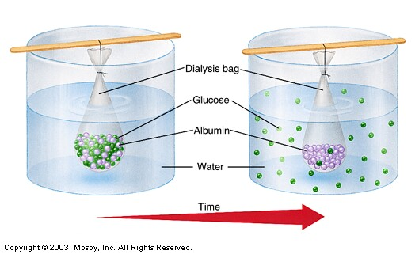
Permeability
Ability of substances to pass through the cell membrane
Selectively permeable—only allows certain substances through.

Slide 5
Energy Production (ATP)
Photosynthesis:
  Chloroplasts in plants/producers use sunlight to produce energy in the form of food
  6CO₂ + 6H₂O→ C₆H₁₂O₆ + 6O₂
Cellular Respiration
  All living organisms use the food energy from producers to make ATP for body functions
C₆H₁₂O₆ + 6O₂ → 6CO₂ + 6H₂O

Slide 6
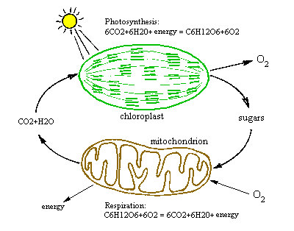
.

Slide 7
Cell Transport
Passive Transport: does not require energy
  Diffusion: movement of substances from high to low concentrations
  Osmosis = Diffusion of WATER only
Active Transport – requires energy (ATP)
  Exocytosis – substances exit
  Endocytosis – substances go in

Slide 8
Cell Part Function
Cell membrane | Controls what enters and leaves the cell
Nuclear membrane | Controls what enters and leaves the nucleus
Nucleus | Control center of the cell
Chloroplast | Organelle that contains pigments to do photosynthesis – makes food
Chromosomes | Genetic information (DNA) in the nucleus
Ribosome | Organelle makes proteins
Mitochondria | Organelle for cellular respiration – converts food to energy (ATP)

Slide 9
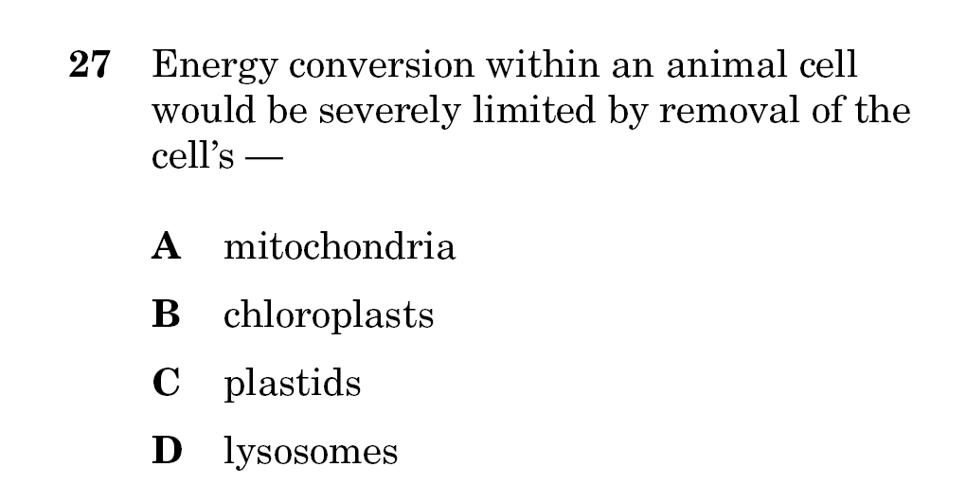
Read carefully:
Notice it says animal cell!

Slide 10
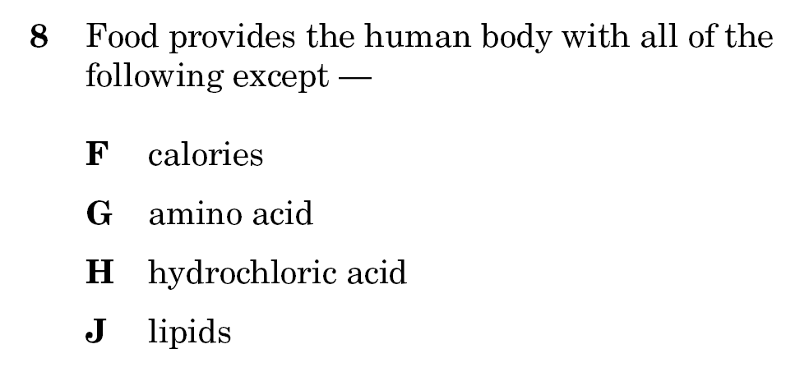

Slide 11
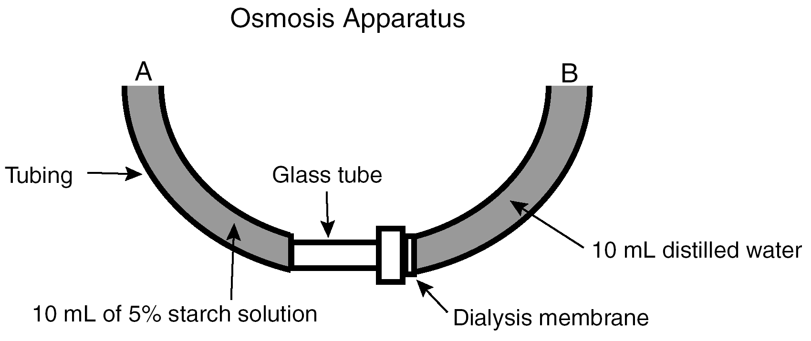
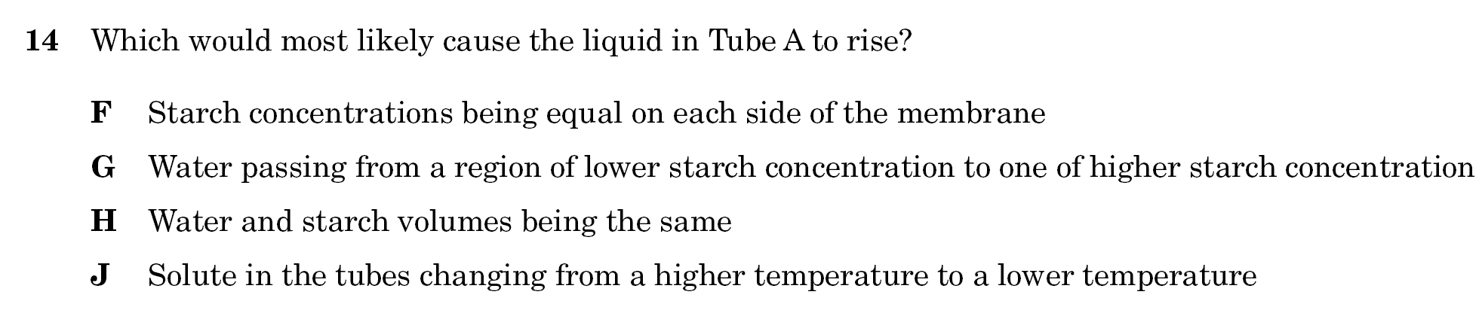
Determine % of water on each side of the membrane – only the water will move NOT the starch

Slide 12
6A
Describe components of DNA and illustrate how information for specifying the trait of an organism is carried in the DNA.

Slide 13
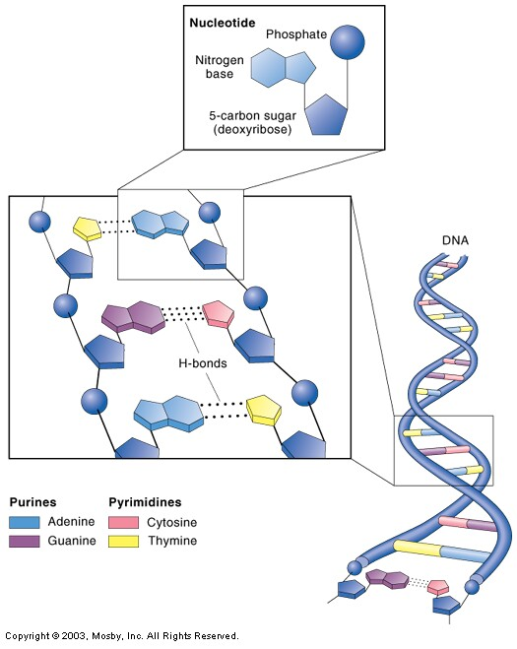
Deoxyribonucleic Acid (DNA)
Deoxyribose Sugar
Phosphate
Nitrogen Bases
  Adenine
  Thymine
  Cytosine
  Guanine

Slide 14
Genes
Sections of DNA that code for proteins
The proteins are what control your traits.
  The sequence (order) of the nitrogen bases are what “write” your genetic information instructions.

Slide 15
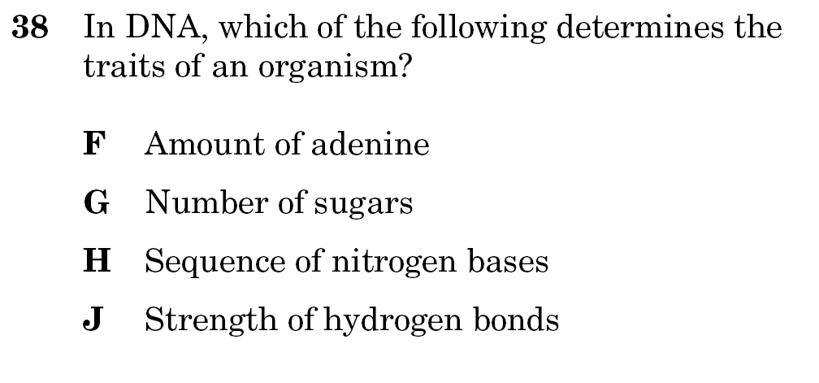

Slide 16
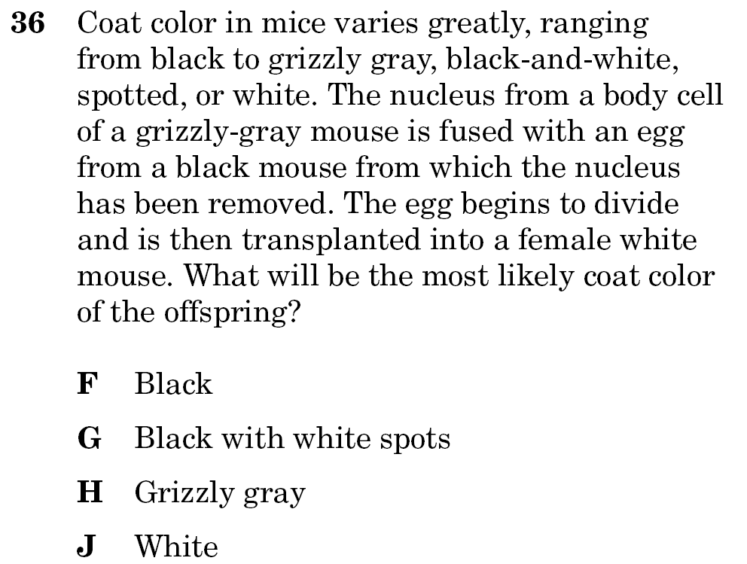
HINT:
Genetic instructions are in the DNA
DNA is in the nucleus
DNA is the only thing that will determine this coat color!

Slide 17
Reminder:
In DNA
A hooks up with T
C hooks up with G
In RNA:
A hooks up with U
C hooks up with G

Slide 18
6B
Explain replication, transcription and translation using models of DNA and RNA

Slide 19
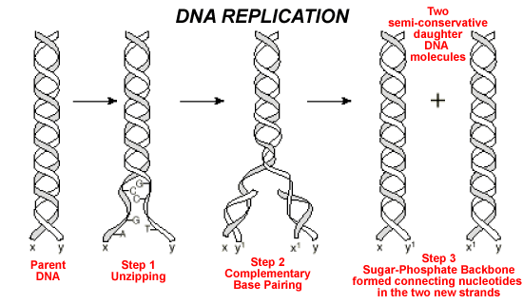
Each new strand of DNA is identical to each other and to the parent strand it came from – this keeps all your genetic instructions consistant.

Slide 20
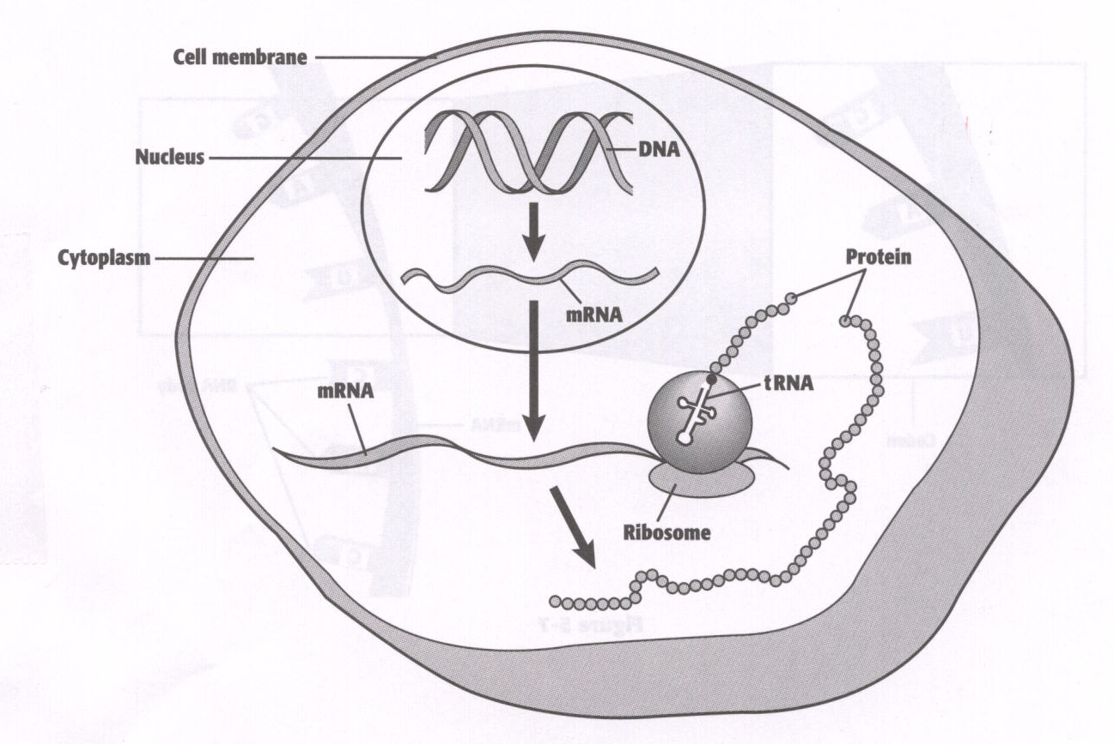
Protein Synthesis:
Transcription and Translation
TRANSCRIPTION
TRANSLATION

Slide 21
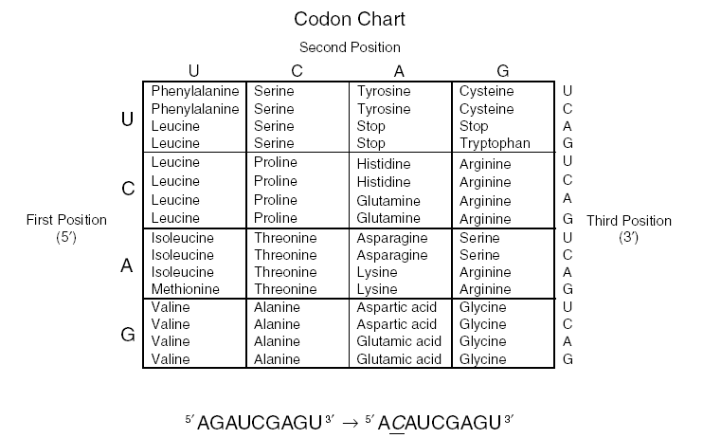
What does this chart represent?
If it says codons, and has U instead of T, it has to be mRNA!

Slide 22
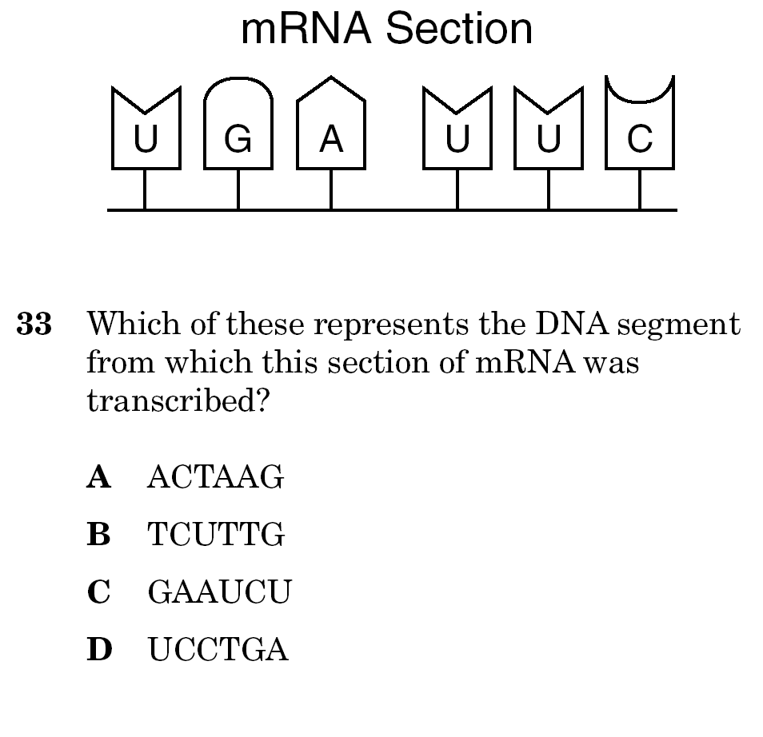
HINT: The question is asking you which of these is a DNA segment – remember DNA does NOT have Uracil

Slide 23
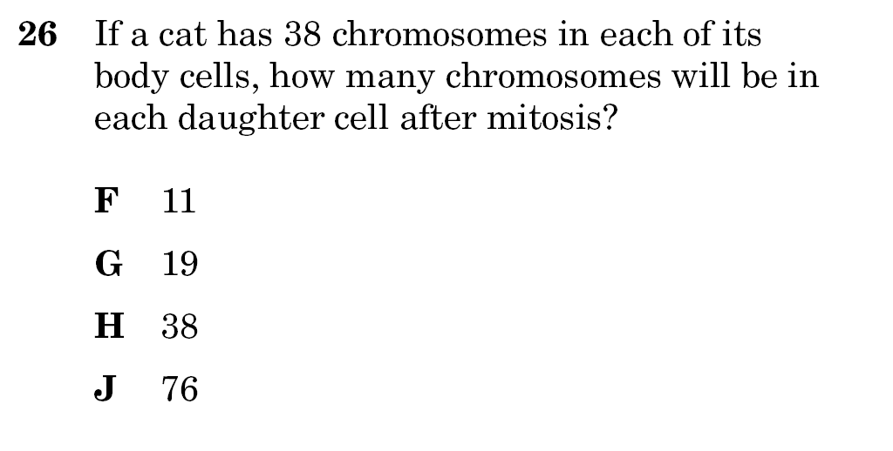
Hint: Daughter cells from mitosis are identical to the parent cell they came from
In meiosis (production of gametes = egg & sperm), the number of chromosomes will be halved.

Slide 24
6C
Identify and illustrate how changes in DNA cause mutations and evaluate the significance of these changes.

Slide 25
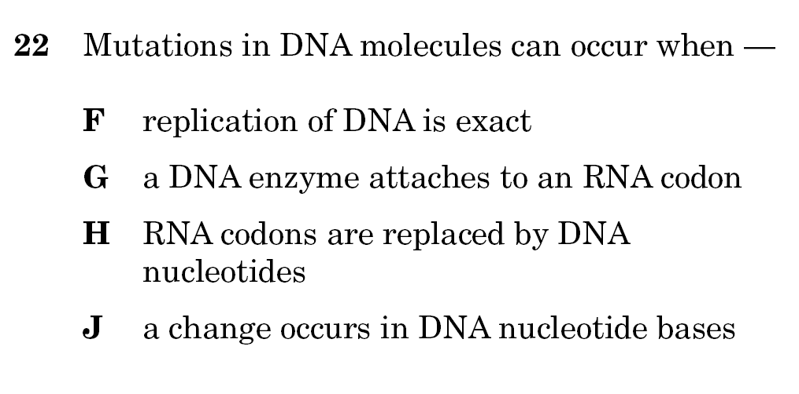
HINT: what would change your genetic instructions?

Slide 26
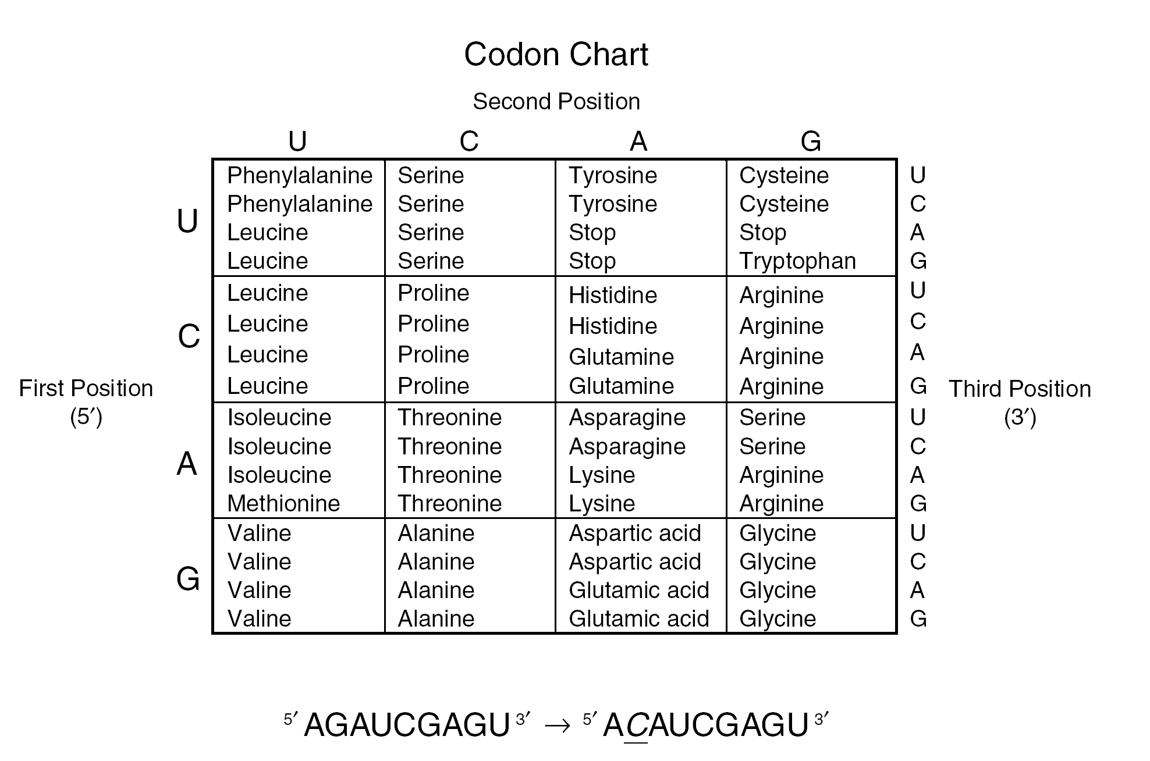
Determine what changed in the before & after & what all this would affect.
The chain above represents three codons. Which of the following changes would be expected in the amino acid chain if the mutation shown above occurred?
F The amino acid sequence would be shorter than expected.
G The identity of one amino acid would change.
H The amino acid sequence would remain unchanged.
J The identities of more than one amino acid would change.

Slide 27
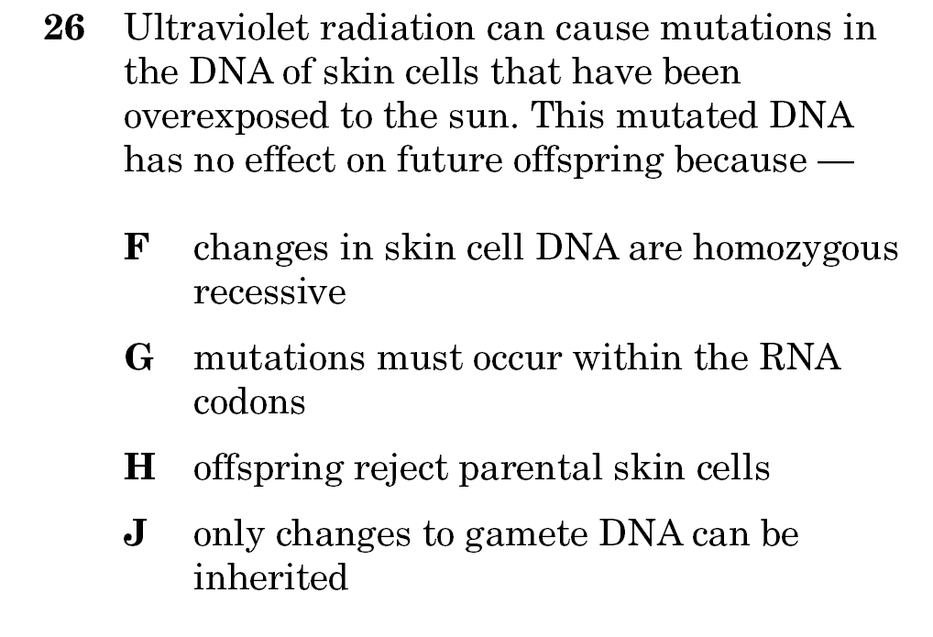
HINT: Only the sperm & eggs can pass your DNA onto your offspring!

Slide 28
6D
Compare genetic variations observed in plants and animals

Slide 29
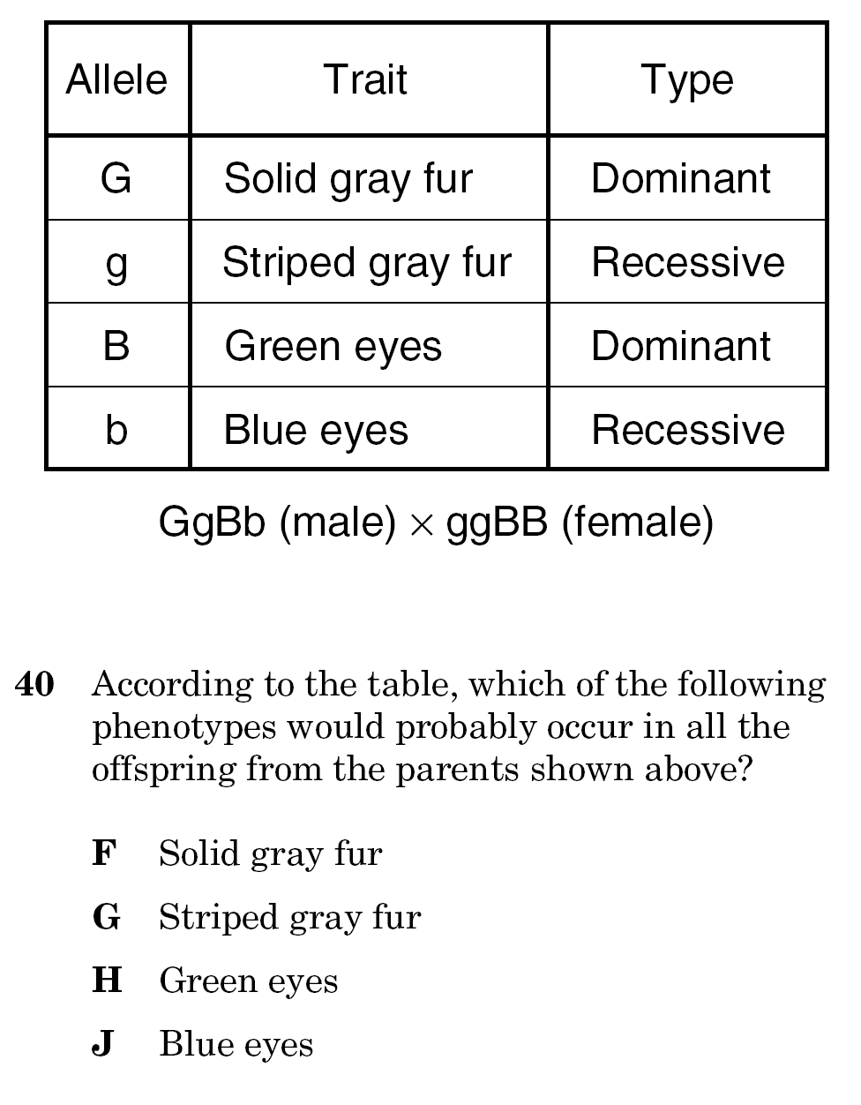
Determine what are the only alleles that each parent can contribute to the offspring – you don’t need to do a Punnett square for this one

Slide 30
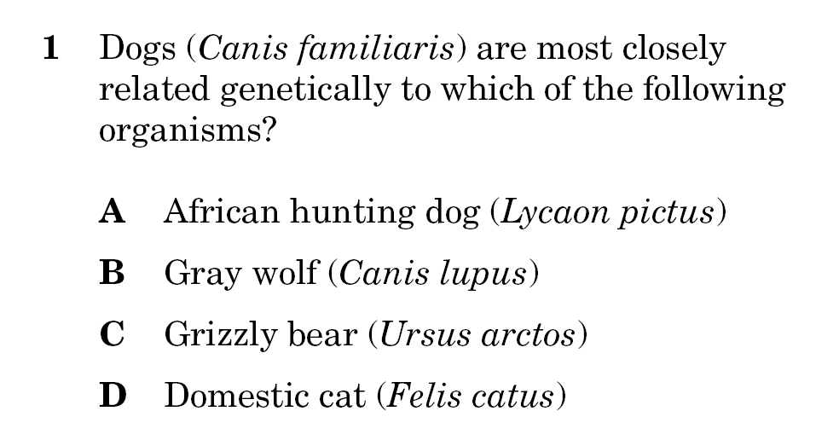
Look at the genus & species names

Slide 31
8C
Identify characteristics of the 6 kingdoms

Slide 32
6 Major Kingdoms – info is in your handout!
Archaebacteria
  Prokaryote – no nucleus or membrane bound organelles
  Unicellular
  Cell walls without peptidoglycans
  May be autotrophs (make own food – producers) or heterotrophs (eat other organisms – consumers)
Eubacteria
  Prokaryote
  Unicellular
  Cell walls with peptidoglycans
  Autotroph or heterotroph
Protista
  Eukaryote – has nucleus and membrane bound organelles
  Some have cells walls of cellulose
  Some have chloroplasts
  Most unicellular
  Autotroph or heterotroph

Slide 33
6 Major Kingdoms
Fungi
  Eukaryote
  Cell walls of chitin
  Most multicellular
  Heterotroph
Plantae
  Eukaryote
  Cell walls of cellulose
  Have chloroplasts to do photosynthesis
  Multicellular
  Autotroph
  Have large central vacuole, chloroplasts, & cell wall (look for these if a diagram is shown)
Animalia
  No cell walls or chloroplasts
  Multicellular
  Heterotrophs

Slide 34
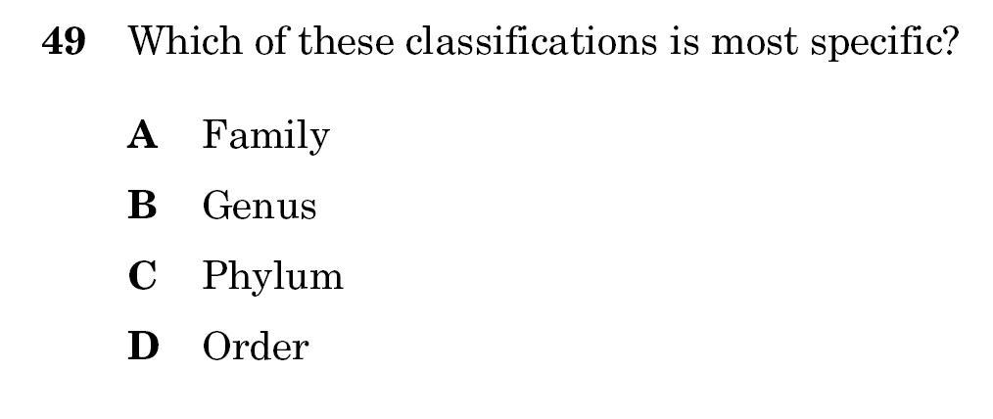
Reminder:
Kingdom (most inclusive – least specific)
Phylum
Class
Order
Family
Genus
Species (most exclusive – most specific)

Slide 35
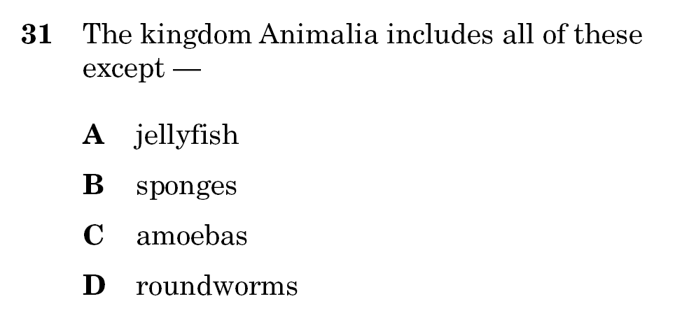
Look at characteristics of Animalia & determine which organism doesn’t fit

Slide 36
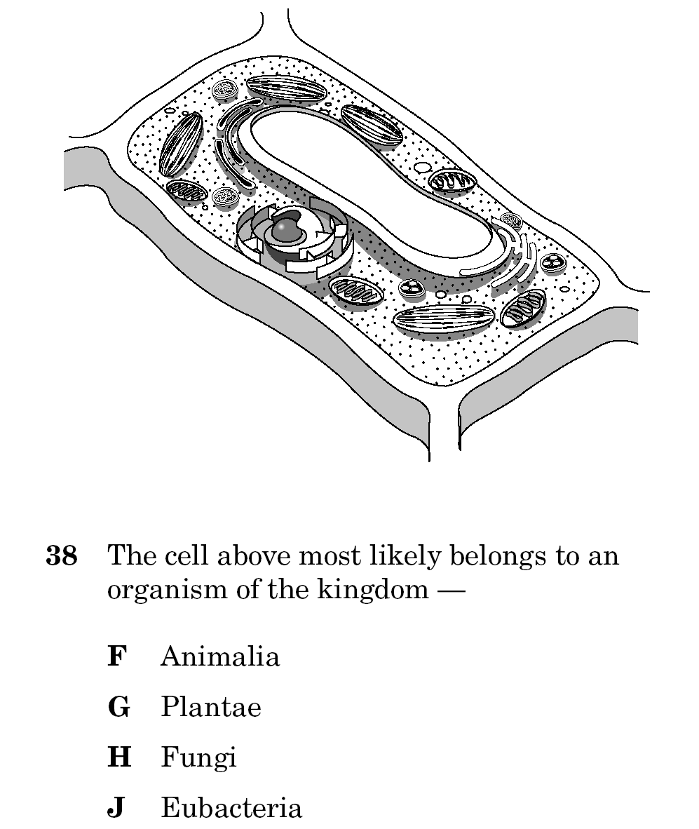

Slide 38
10A & B
Compare the interrelationships of organ systems to each other and to the body as a whole
Interpret the functions of systems in organisms including:
Circulatory
Digestive
Nervous
Endocrine
Reproductive
Integumentary
Skeletal
Respiratory
Muscular
Excretory
Immune

Slide 39
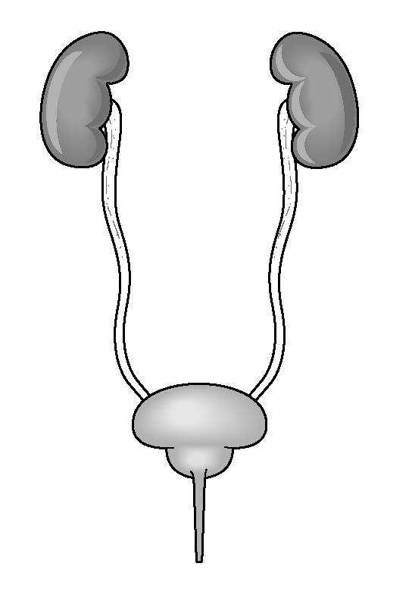
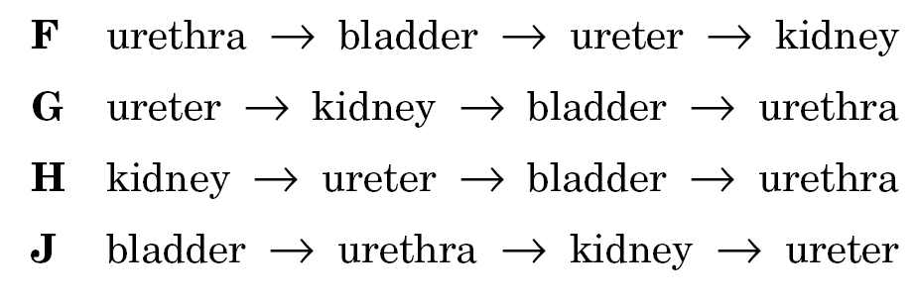
A portion of the human excretory system is represented in the diagram. The order in which urine flows through the system is —

Slide 40
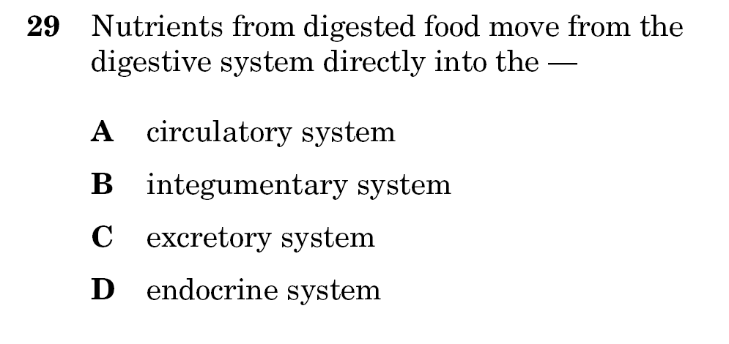
Food from your stomach is absorbed into your bloodstream to go to your cells

Slide 41
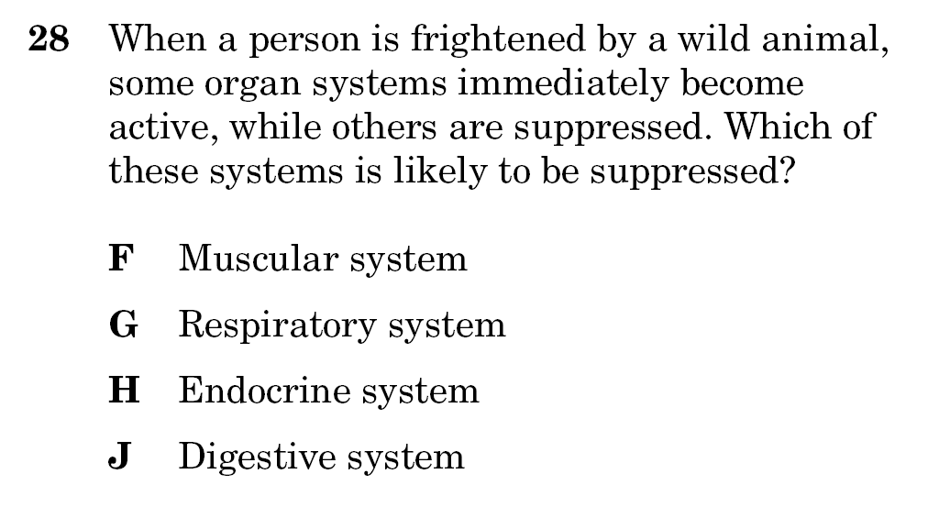
At rest: all systems are relaxed except digestive
Not at rest: all systems are working except digestive

Slide 42
Now you try!

Slide 43
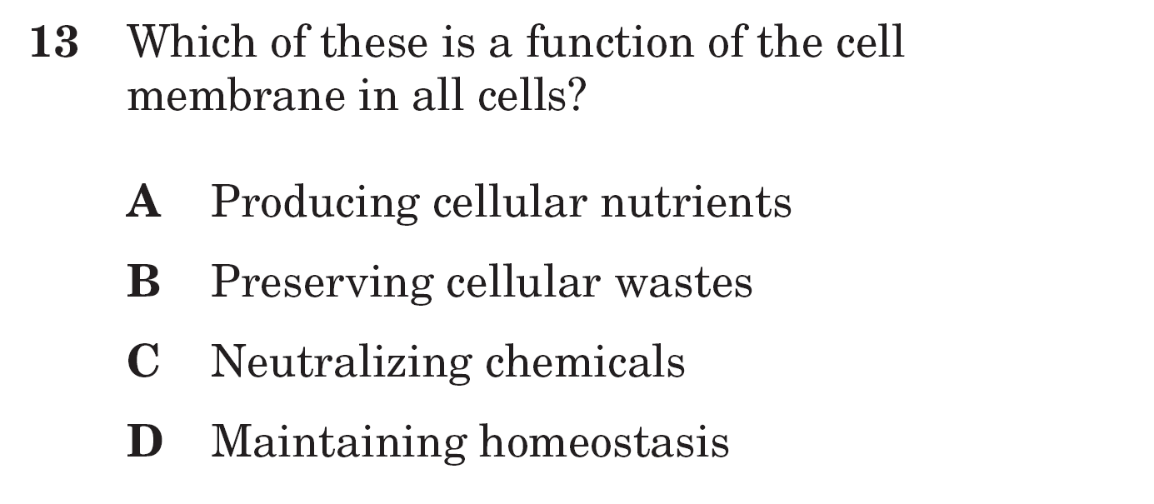
What is the function of the cell/plasma membrane and which of these choices will that function help with?

Slide 44
Which of these best explains why a freshwater aquarium would be a dangerous habitat for saltwater fish?
A The tissues of the saltwater fish would
absorb too much acid.
B The organs of the saltwater fish would
produce too much protein.
C The organ systems of the saltwater fish
would consume too much energy.
D The cells of the saltwater fish would gain
too much water.

Slide 45
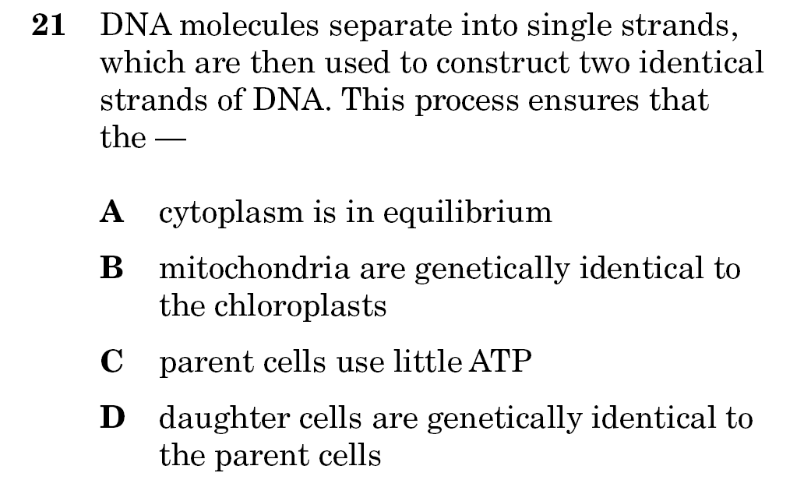

Slide 46
Hint: You have exactly the same DNA in ALL your cells – this is YOUR genetic code

Slide 47
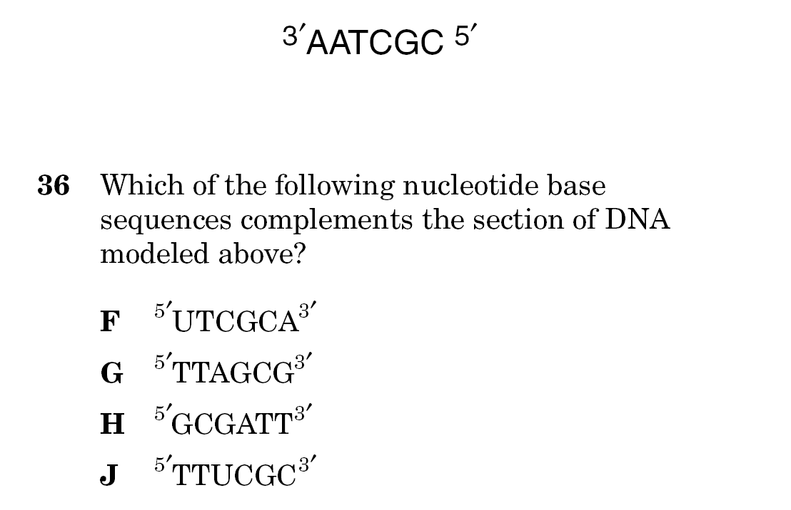

Slide 48
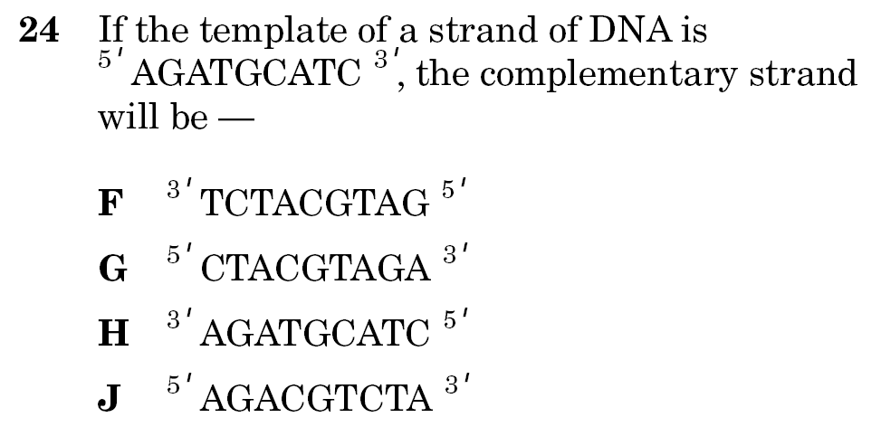

Slide 49
Sickle-cell anemia is a disorder resulting from a mutation that leads to the production of an abnormal protein. Which component of the DNA molecule provides instructions for the production of the protein?
A The phosphate groups
B The sugar molecules
C The sequence of nitrogen bases
D The bonds that hold the sugars to the
bases

Slide 50
Which of these best explains how mutation
can be beneficial to an organism?
A Phenotypic change may create an
advantage over other organisms.
B Recombined genetic material improves
genotype stability.
C Mitosis becomes a favored means of
reproduction.
D Deoxyribose sugars develop into
additional nucleotides.

Slide 51
Hint: Only the cells AFTER the mutation will be affected!

Slide 52
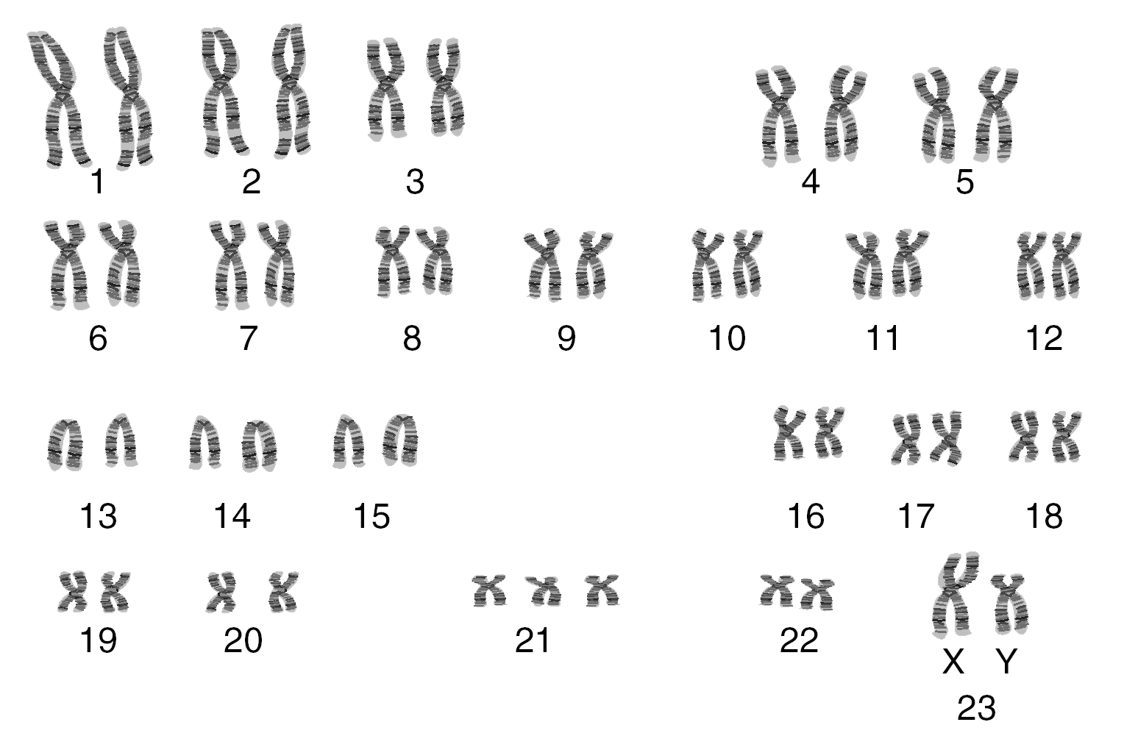
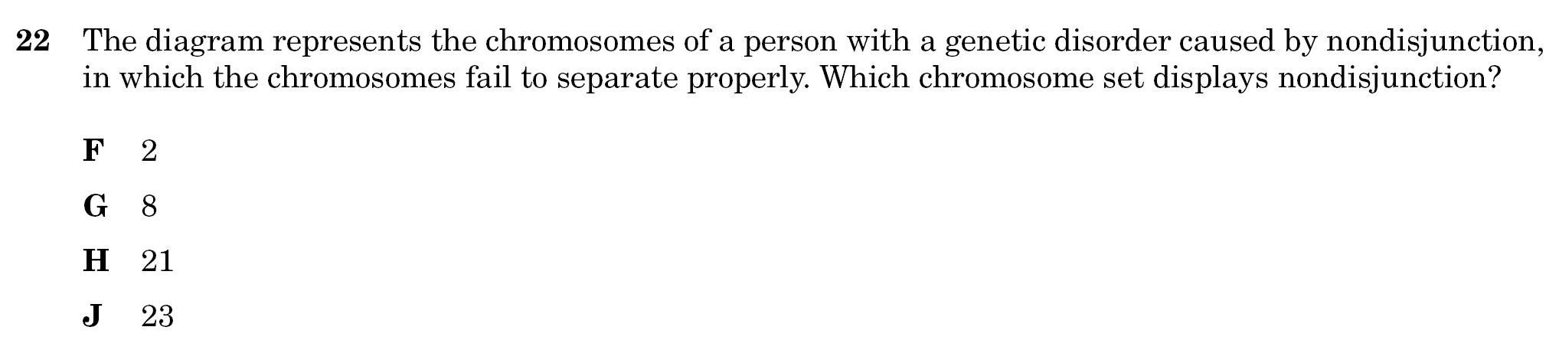
Reminder: You get one chromosome from mom & one from dad so you have 2 of each chromosome

Slide 53
The question is asking you about a SINGLE change – so only ONE thing will be different!

Slide 54
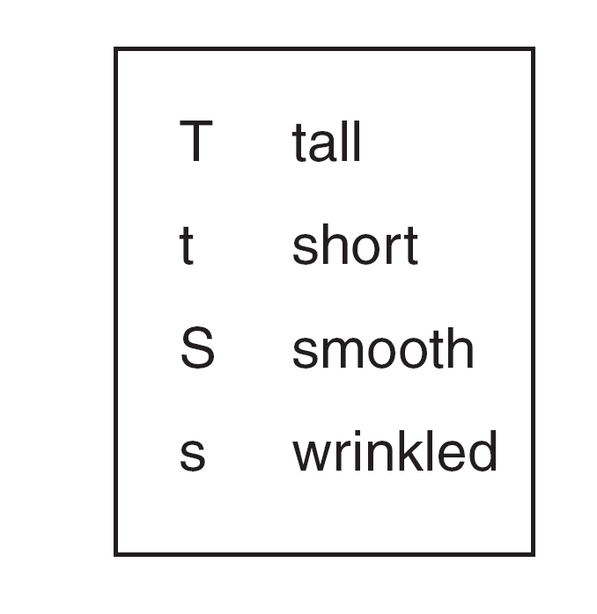

Slide 55
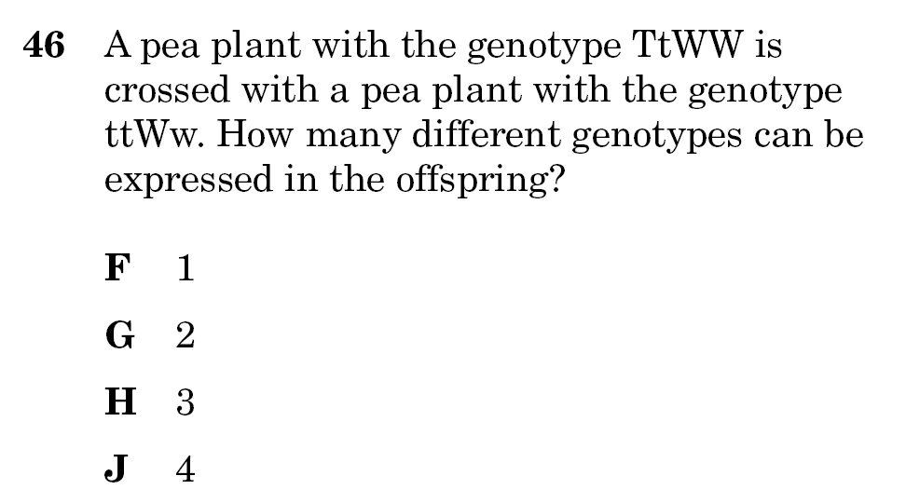

Slide 56
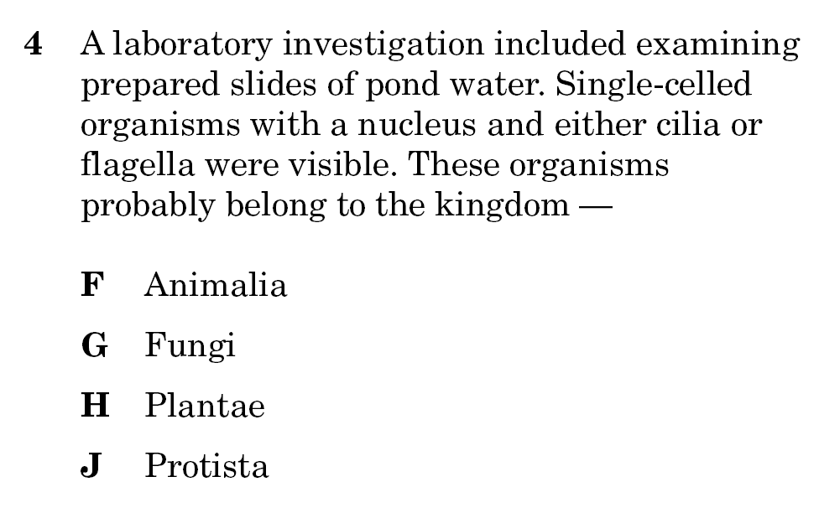

Slide 57
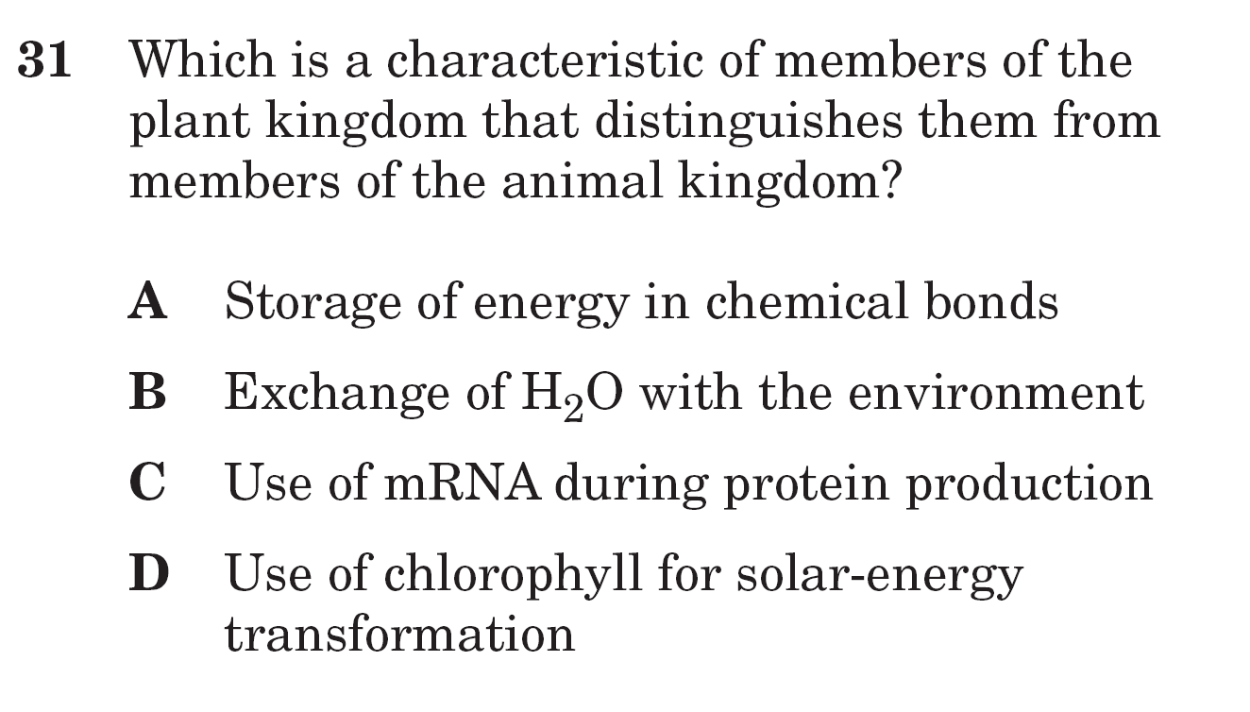

Slide 58
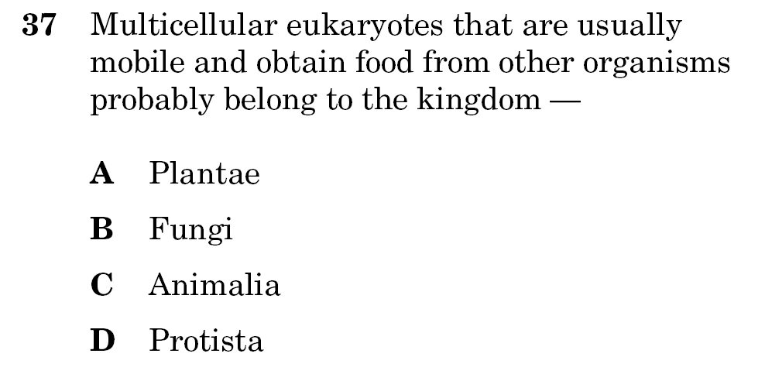

Slide 59
How is the excretory system most likely to respond when an animal is thirsty?
F By relaxing the smooth muscles
G By retaining body fluids
H By absorbing heat from lymph glands
J By releasing hormones
IF you are thirsty, what do you NOT need to lose any more of?

Slide 60
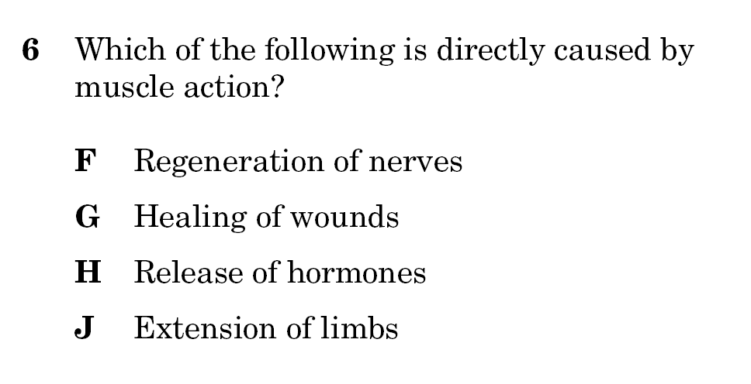
Make sure you know what all the words mean!

Slide 61
“CARRIES” is your main hint here

Slide 62
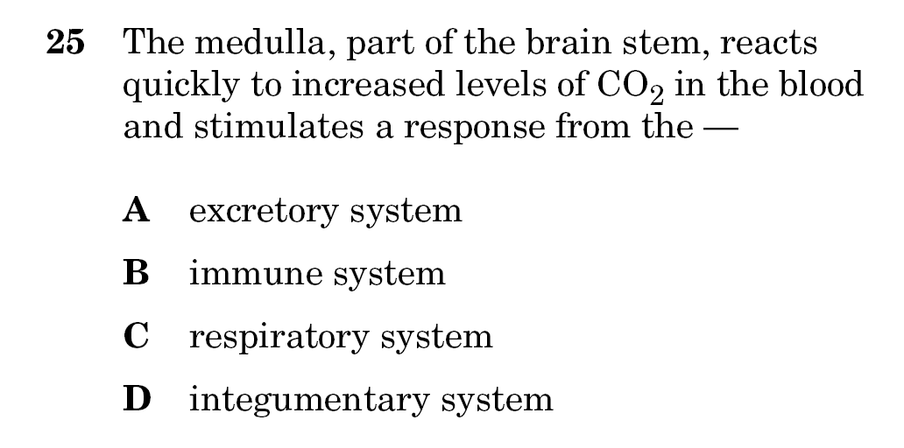
What gets told that you have too much carbon dioxide so it can get rid of it?

Slide 63
